Slide 1
Common Conventions Ramco Aviation Solution – R5.8
Base Aviation Product Team
26-Aug-2015

Slide 2
Agenda
Accessing Ramco Aviation
Log-on
User Interface Organization
Navigation
Common Action Buttons
User Interface - Navigation
Screen Content
Messaging
Logout

Slide 3
Course Objective
At the end of the session, participants will be able to:
Perform common functions in the solution
Navigate within the solution
Be familiar with the conventions used in the solution
Perform data entry as well as retrieve existing data, in application pages

Slide 4
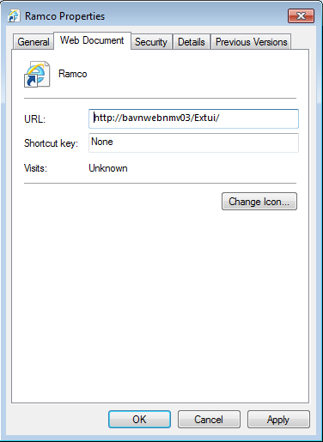
Accessing Ramco Aviation
Access the URL by:
Typing in IE’s Address control
Clicking on a shortcut for the URL on desktop
Clicking on a shortcut link in the “Favorites” list of IE
Ensure that the shortcuts have only the URL address
The htm page ref. needs to be removed if the “Add to Favorites”
option is used to create the link

Slide 5
Log-on
Supply log-on credentials
User ID
Password
User ID is locked if no. of unsuccessful attempts exceed set limit
Password expiry limit
User is warned on login, during the alert period set
Forgot Password link to reset the password
Additional Default log-on parameters for user
Default Role
Default Org. Unit/Location
Default Language

Slide 6
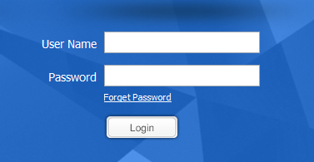
Common Actions: Forgot Password
Helps to Reset the password by answering the password reminder question

Slide 7
User Interface Organization
Business Process
Business Components
User Activities
User
Access Rights
User Activities
User Activities
User Interfaces

Slide 8
User Interface Organization (contd..)
Three primary windows
Login Page
Home Page
Main Page
Login Page

Slide 9
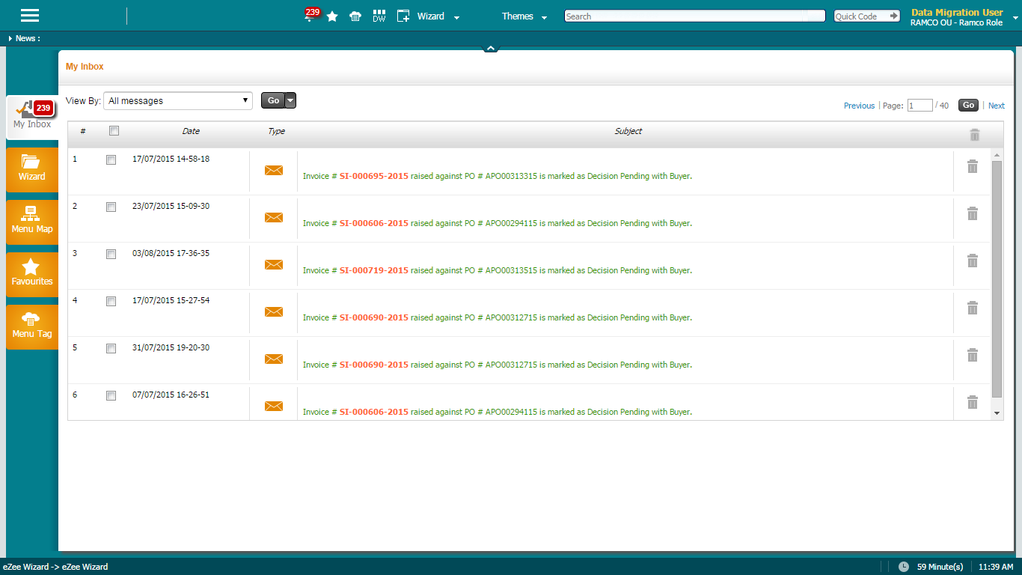
User Interface Organization (contd..)
Home Page
Wizard
Workspace
Activity
Blank Page

Slide 10
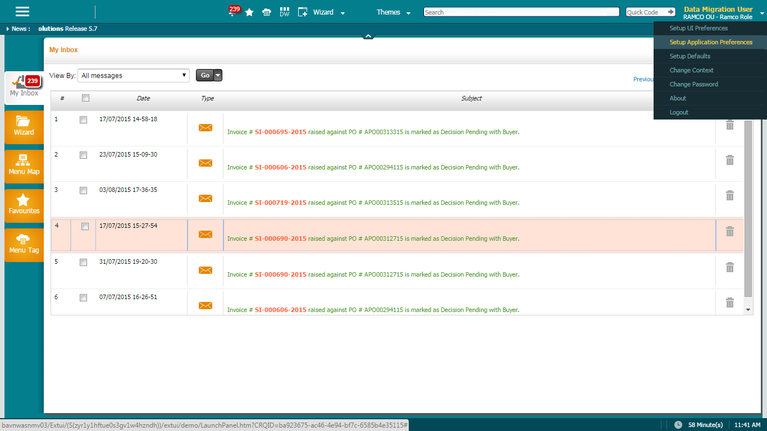
User Interface Organization (contd..)
Managing Home Page
Select Application Preferences
Select Home page preference
Save Preference
Launch Preferences available
Wizard
Work space
Activity
Blank page

Slide 11
User Interface Organization (contd..)
Managing Home Page – Default Activity
Select Defaults
Select Home screen activity
Save Preference

Slide 12
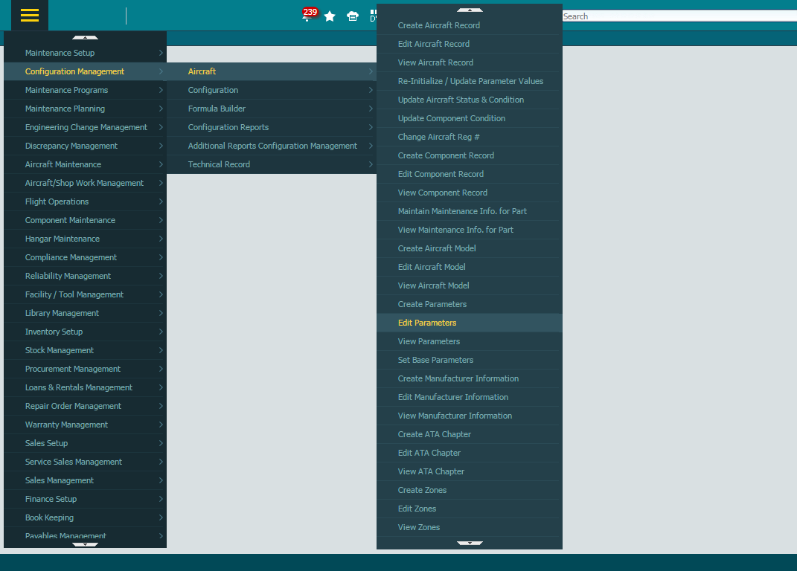
User Interface Organization (contd..)
Home Page
Lists the Business Processes
Only those processes which the user has access rights, will be listed
Favorites List
Frequently used activities
Launches the user interface (screen)
Business Component
User Activity
Business Process Chain (BPC)

Slide 13
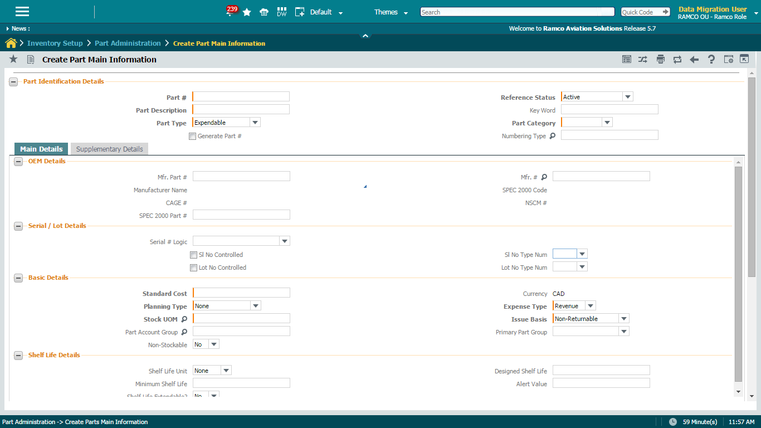
User Interface Organization (contd..)
Banner
a. Login User
b. Org. Unit
c. User Role
Collapse or Expand Tool Bar
Tool Bar
Common Action Buttons

Slide 14
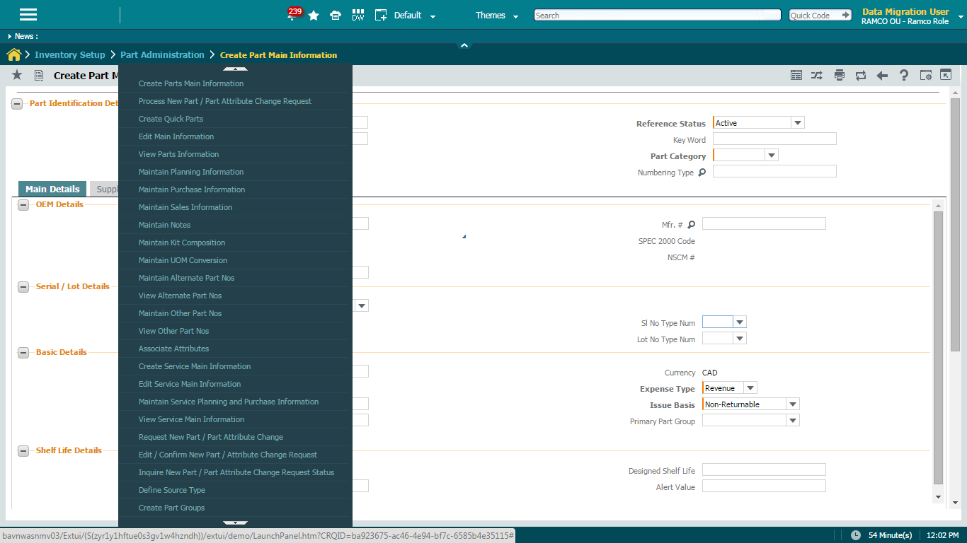
Navigation
Access menu available.
Menu for specific Business Process Chain (BPC)

Slide 15
Navigation
Trail bar to display previous traversal
Trail Bar

Slide 16
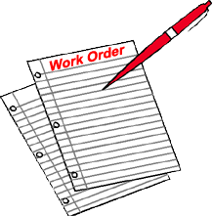
Common Action Buttons
Templates
Print Screen
Back button to go back to previous screen
Preference Mode
Screen Level
Templates
Trail bar
Print screen
Refresh screen
Back
On-line Help
Preference Mode
Defaults Mode
Trail bar
Refresh Screen
On-line Help
Defaults Mode

Slide 17
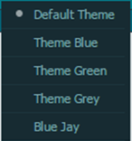
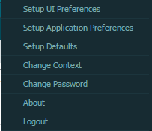
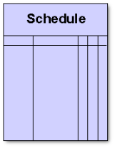
Common Action Buttons (contd..)
Left Pane
Favorites
Launch DW
Launch New window
Select theme
User Level
Left Pane
Go to Home page
Favourites
Launch DW
Show Wizards
Show workspace
Launch New window
Select theme
Show Wizards
Show Workspace
Go To Home Page
Session Level
Log-out

Slide 18
Common Action Buttons –Print Screen
Print Screen
Launches the Screen in a Printer friendly format

Slide 19
Common Action Buttons –Print Screen
Refresh
Brings the page back to the state in which it was first launched

Slide 20
Common Action Buttons –Print Screen
Go Back
Closes the current screen and retrieves the previous screen

Slide 21
Common Action Buttons –Print Screen
Online Help
Launches the “On-line” help for the page

Slide 22
Common Action Buttons –Print Screen
Preferences
Launches the User / Implementer personalization

Slide 23
Common Action Buttons – Quick Launch
Quick Launch facilitates launching of activities by providing short Id (integer)
Short ids for activities can be configured by generating an xml file ‘quick launch config.xml’
Xml file will reside in web server under /../iis/plf_data
Short ids should be integers
Short ids can be set at application level only

Slide 24
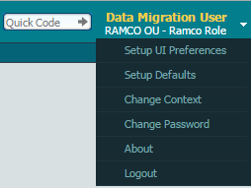
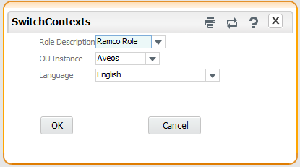
Common Action Buttons – Change Context
Change context for the logged on user
Role
Org. Unit
Language
Click here to
get options list
Click on Change Context

Slide 25
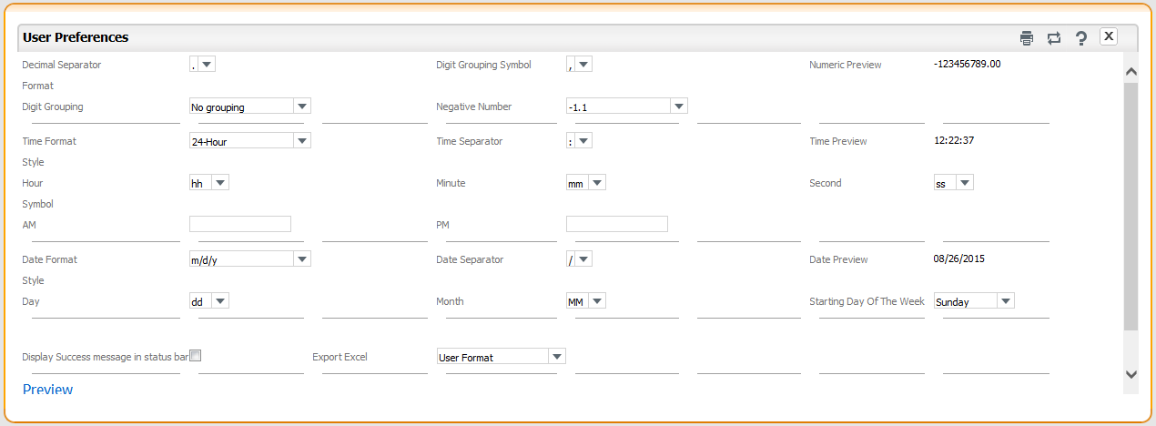
Common Action Buttons – Change UI Preferences
Click here to
get options list
Click on Setup UI Preferences

Slide 26
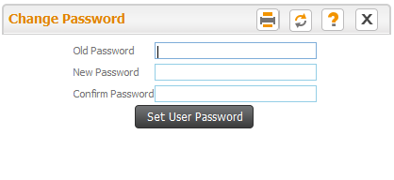
Common Action Buttons – Change Password
Click here to
get options list
Click on Change Password

Slide 27
User Interface – Navigation
Pages can be invoked using:
Hyperlink of “User Activity” under the “Business Component”
Hyperlink of “User Activity” in the “Favorites” list of the “Home” page
Forward navigation across pages can be accomplished by:
Hyperlinks
Data-hyperlinks
“Help” icons

Slide 28
User Interface – Navigation (Contd.)
Hyperlink
Multiline Related
Will be positioned below a multiline
Would require one or more of the multiline rows to be selected
If linked page expects only one row to be selected and if multiple rows are selected in the multiline, then the last ordered record (among the selections made) will be considered.
Page Level
Ordered below the processing buttons
Exceptions in link positioning
“View File”

Slide 29
User Interface – Navigation (Contd.)
Data-hyperlinks
Used to
Navigate for viewing the details of any entity
“View” of master record for entities
“View” of main page for transactions
Navigate to detail page from an entry page

Slide 30
User Interface – Navigation (Contd.)
Help pages
Provided in controls where the system expects a valid pre-defined data-item to be entered.
Help icon invokes a page where all the pre-defined records are available for selection.
Press “OK” button (or) double click the record to close the help page and retrieve the selected record(s) back to the control

Slide 31
User Interface – Navigation (Contd.)
Backward traversals
Accomplished by:
Closing the page using the “Close” common action button
Clicking on the User Interface name in trail bar
Invoking “OK” button in a “help” page

Slide 32
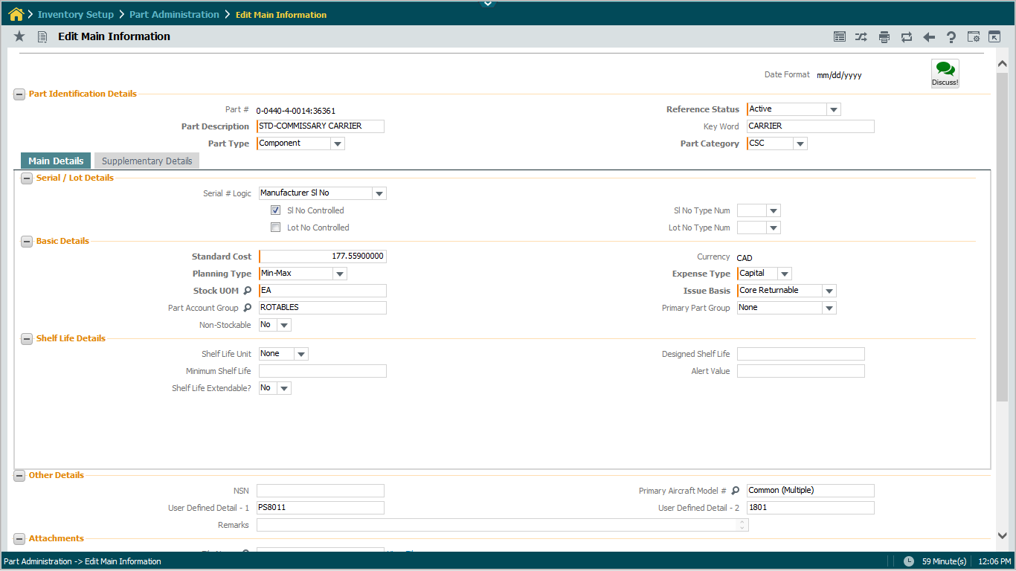
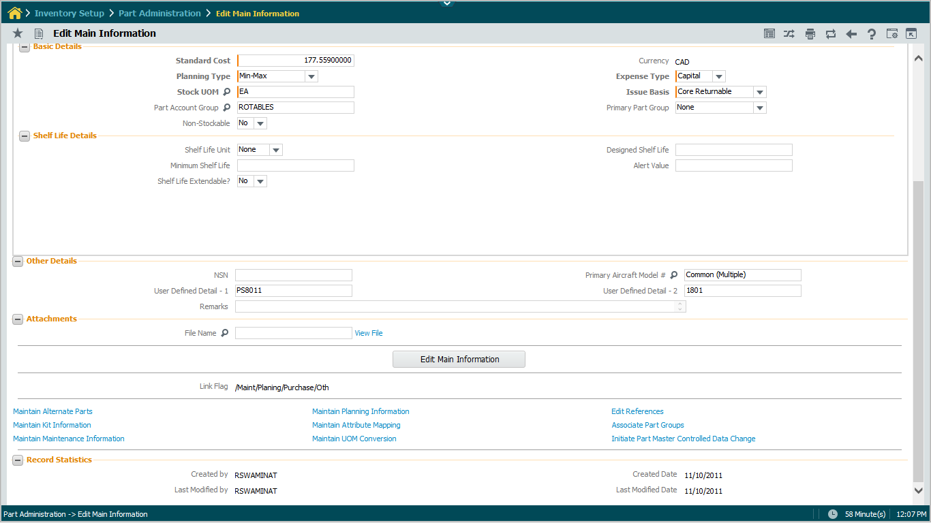
Page Content
Page Title
Display Control
Labels
Cluster Heading/Captions
Mandatory Control, Text
Check box
Drop down, Mandatory
Editable numeric control
Help Enabled Control
Editable Control
Processing/Action Button
Section Collapse Option

Slide 33
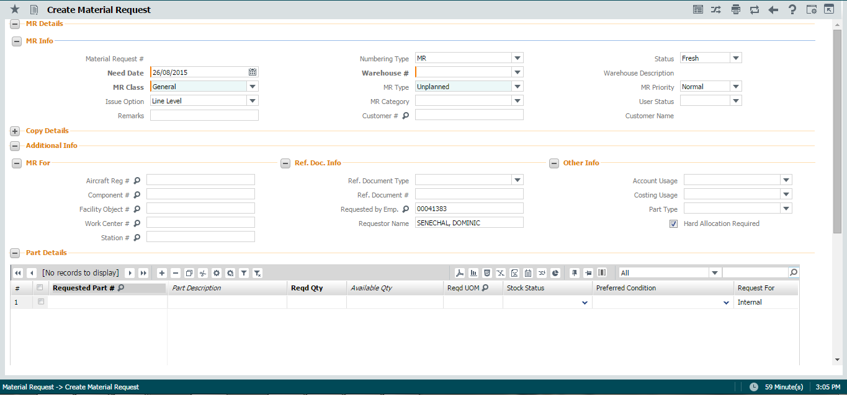
Page Content
Date & Time Icon
Option to default column values
Option to rename or delete columns (User level)
Multiline (Grid)
Option to filter data from multiline

Slide 34
Page Content (Contd.)
Text Area
Use “Tab” to move to the next editable control in the same line / next line
Mandatory fields
Will be displayed with label in Bold font
Conditionally Mandatory fields
Will be displayed as non-mandatory
Hot key ‘Alt + F’ will execute ‘Search’ function in all search pages
Controls that are enabled for multiple search criteria are labeled with *

Slide 35
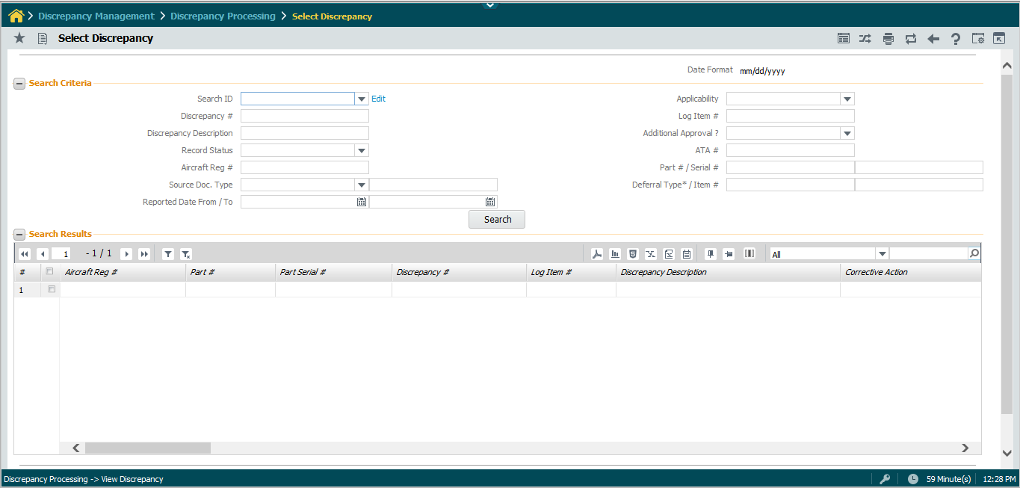
Page Content – Multiple Search Criteria
* Used to indicate multiple values can be entered for search purposes

Slide 36
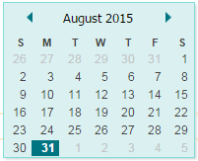
Page Content (Contd.)
Date & Time Controls - Pop up
Invoke the Icon next to the control or
Press F2 when cursor is in editable controls
Dropdown helps in moving across years
Previous & Next icons help in moving across months

Slide 37
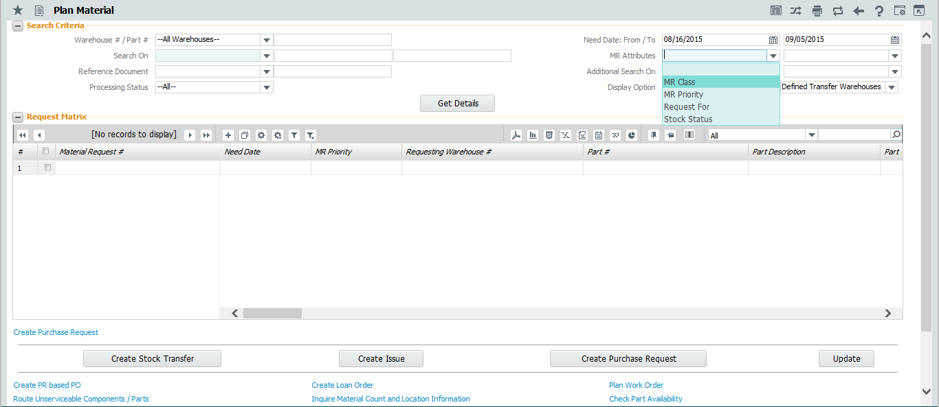
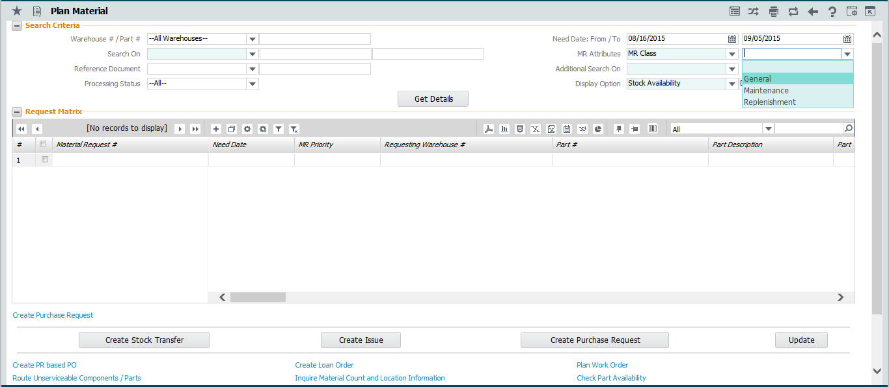
Page Content – State Processing
Controls that drive behavior or data in another dependent control are identified with green color background
Based on the value selected in the previous control, values are derived in this combo

Slide 38
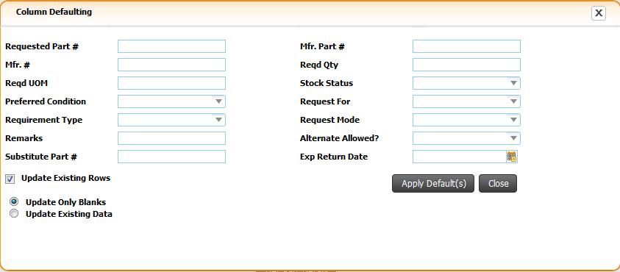
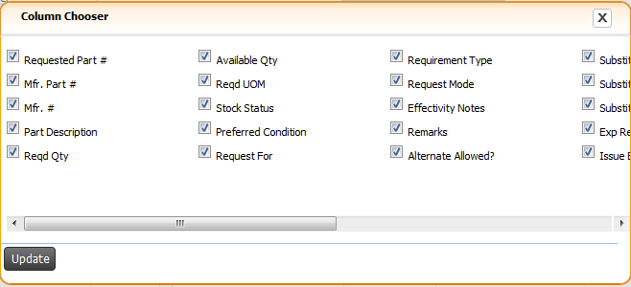
Page Content – Working with Grid
Show Html
Remove Personalize
Show Report
Save Personalize
Export to CSV
Filter column: Option to delete or rename column
Show PDF
Export to Excel
Show Chart
First Record
Last row
Import Data
Vertical Scroll- Previous Set
Add new row
Export to Text
Select column to search
Remove selected row
Copy Append
Cut and paste
Default Columns
Clear Defaults
Filter Data
Direct Access to Row
Clear Filters
Row count display
Vertical scroll – Next set of row
Enter search values
Column Sort is enabled
Horizontal Scroll

Slide 39
Page Content – Working with Grid
Click on the # to view the multiline record in a form.

Slide 40
Page Content – Working with Grid
Multiple Short Keys are enabled in Grid
Image | Short Key | Functionality
 | Shift + Insert | Insert new row in grid
 | Shift + Delete | Delete selected row in grid
 | Ctrl + Y / F7 | Copy and Insert selected row(s) in to the grid
 | Ctrl + X / F8 | Cut and Insert selected row(s) in to the grid
 | Pageup | Move to previous row set
 | Pagedown | Move to next row set
 | End | Move to last row set
 | Home | Move to first row set
 | Shift + p | Show PDF
 | Shift + r | Show report
 | Shift + h | Show HTML
 | Shift + e | Export to excel
 | Shift + v | Export to csv
 | Shift + t | Export to text
 | Shift + I | Import Data
 | Shift + c | Show chart
 | Shift + s | Save personalize
 | Shift + d | Remove personalize

Slide 41
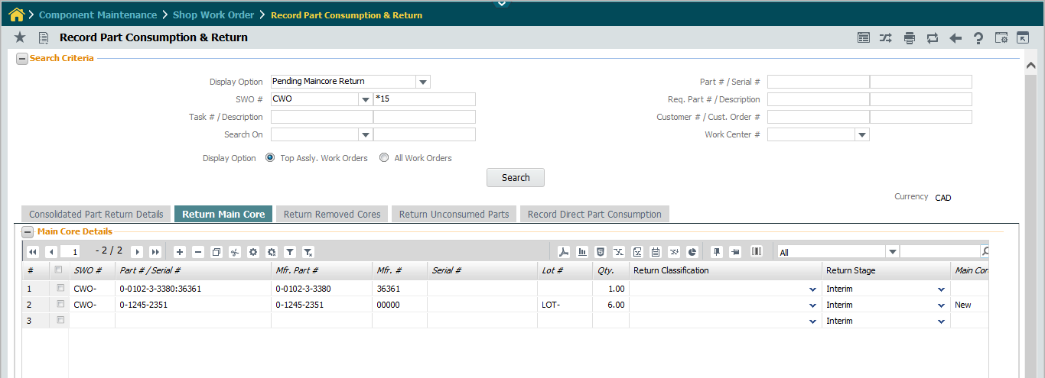
Page Content: Working with Tab Controls
Press Tab heading to navigate across tabs
Active Tab
Inactive Tab

Slide 42
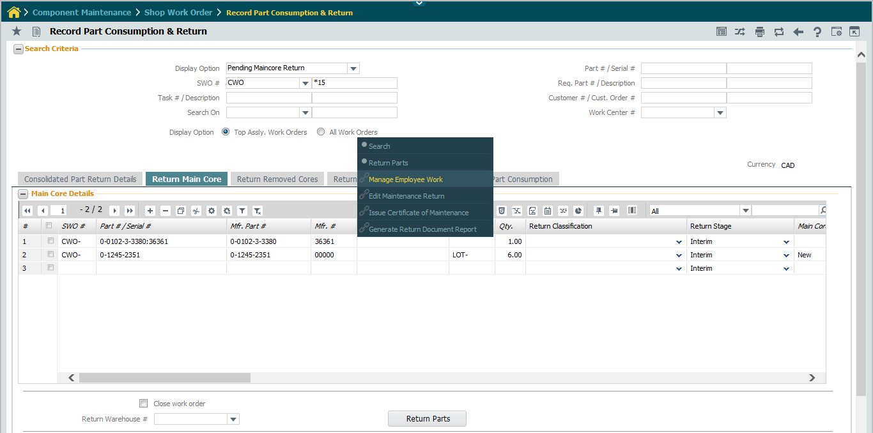
Page Content– Quick Access
Easy access of buttons and links on Right Click of Mouse
Button tasks
Link tasks

Slide 43
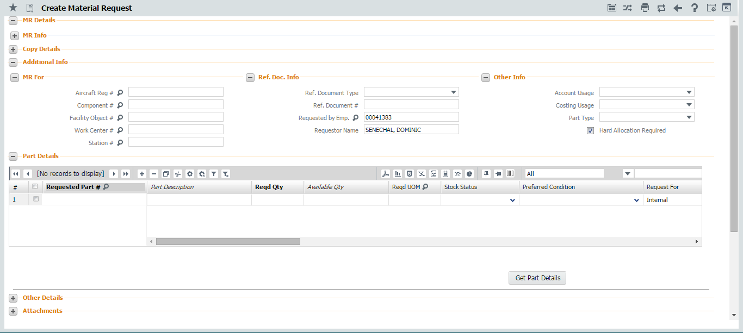
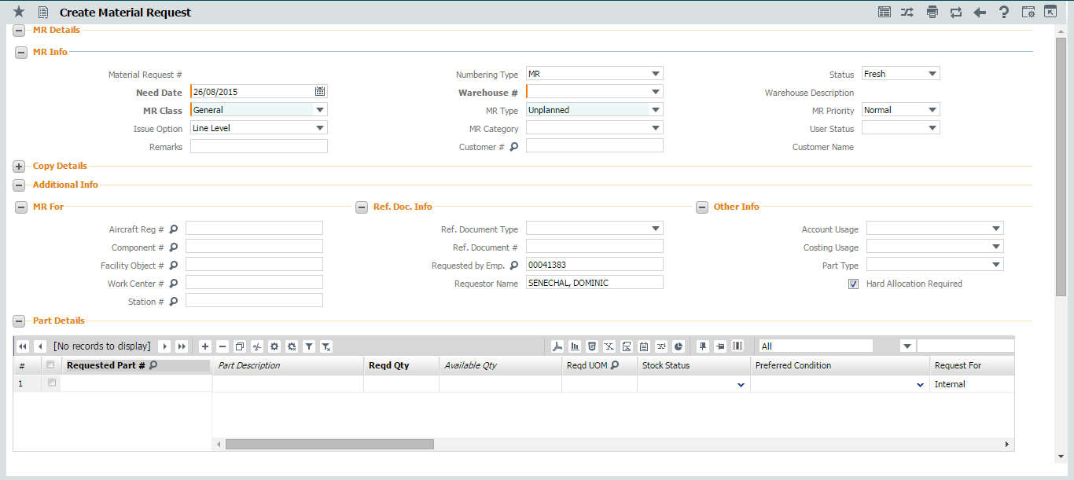
Page Content – Collapse & Expand Sections
Invoke expand icon to Collapse the section
Invoke Expand icon to expand the section

Slide 44
Control Content
Function key ‘F2’ on any edit control will launch the content in a pop-up window for easy readability

Slide 45
Multiline Content in Tool tip
Content of a cell in a multiline can be viewed over tool tip just by moving cursor on the cell

Slide 46
Messaging
Application Messages
Displayed when any processing action initiated
Errors
Informational messages
System Messages
Incorrect Date/Time formats
Displayed when tabbing out of the date/time control
“Page not saved” warning messages
Displayed while executing a backward traversal

Slide 47
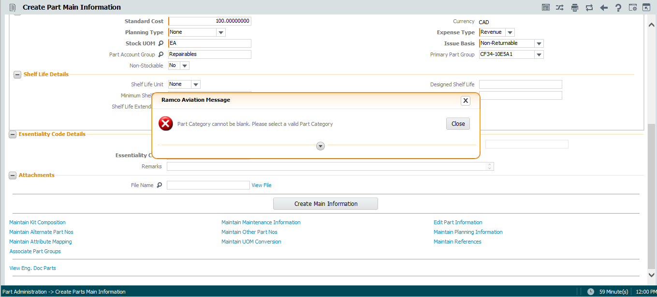
Messaging (Contd.)
Application Message
Error Messages always displayed in Pop-up window

Slide 48
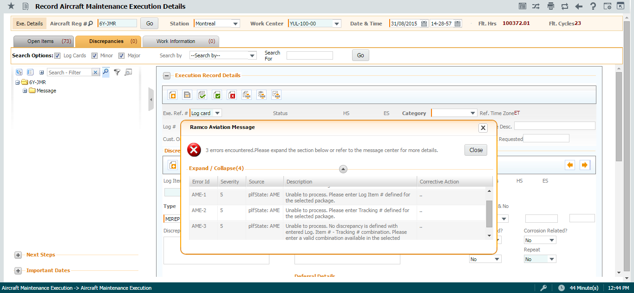
Messaging (Contd.)
In Aircraft Maint. Exec. Business components multiple messages can be seen at a time using this expand icon. Error message information will also be available in the Message Center available at the screen bottom

Slide 49
Messaging (Contd.)
System Message

Slide 50
Messaging (Contd.)
System Messages..contd.
Session time out expiry
The remaining time is always displayed on the screen.
When the expiry time is nearing, system will start flashing the same.
Countdown starts from the last request by the user to web server
Page launch, Processing actions
Does not recognize data entry actions
Auto log-off if no action is performed

Slide 51
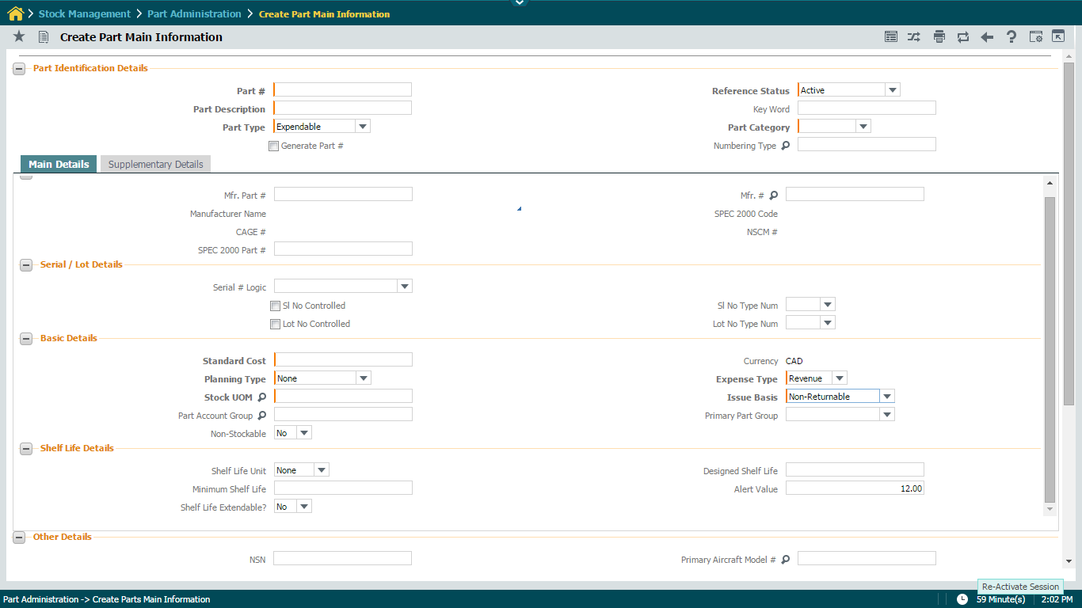
Messaging (Contd.)
Session Expiry Time
System Time
Click here to Re-Activate Session.
Displays Remaining time till automatic log out unless some action is performed

Slide 52
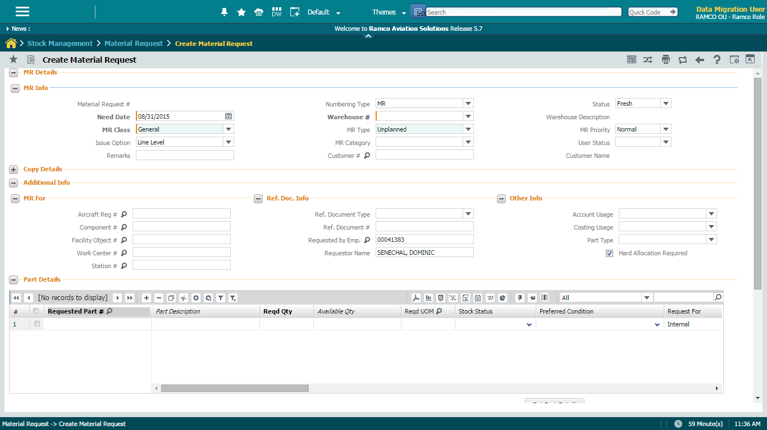
Multiple IE Windows – Cont..
Click on New window icon to launch new application session in different window.

Slide 53
Chrysalis – Wizard Inbox
Launch Wizard Inbox
Launch Wizard Inbox
Search messages
Delete message

Slide 54
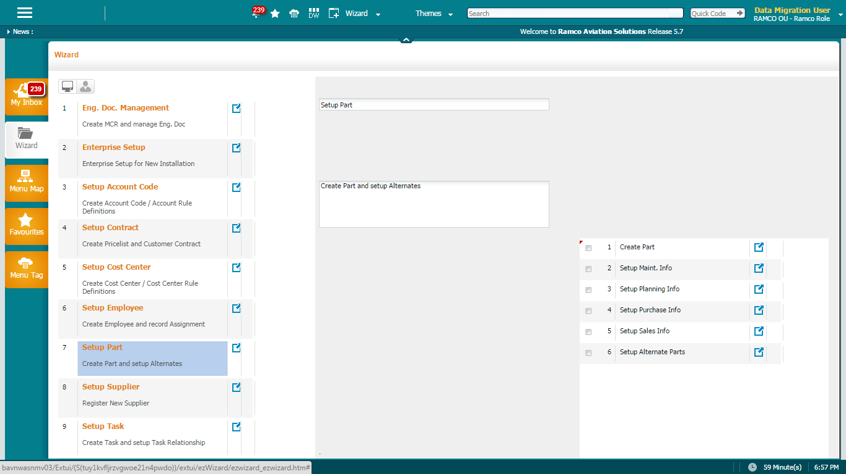
Chrysalis - Wizards
User Wizards
System Wizards
Launch Wizards menu
Launch an activity within a Wizard
Launch the Wizard

Slide 55
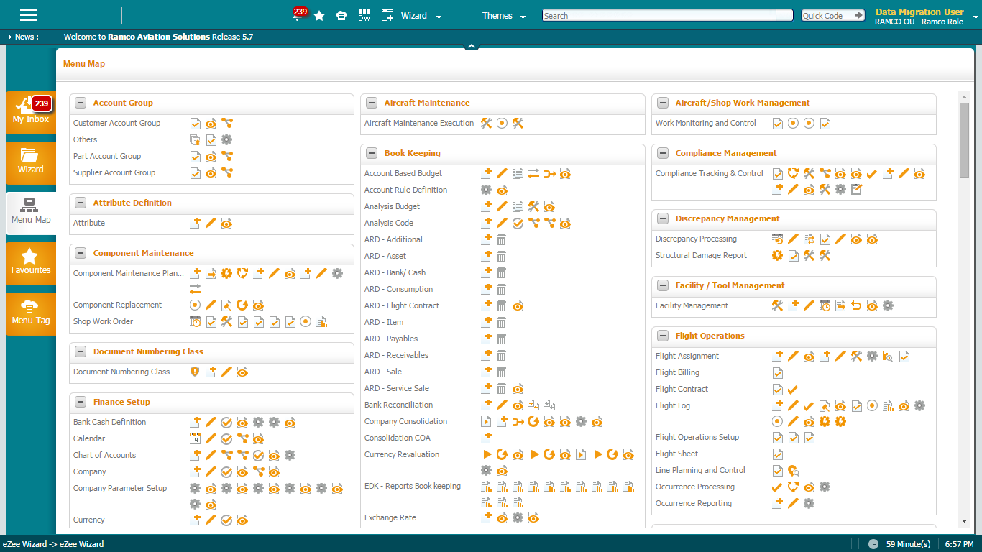
Chrysalis – Menu Map
Menu Category
Launch Menu Map
Menu Group
Click the icon to launch the activity
Activities mapped to Menu Group

Slide 56
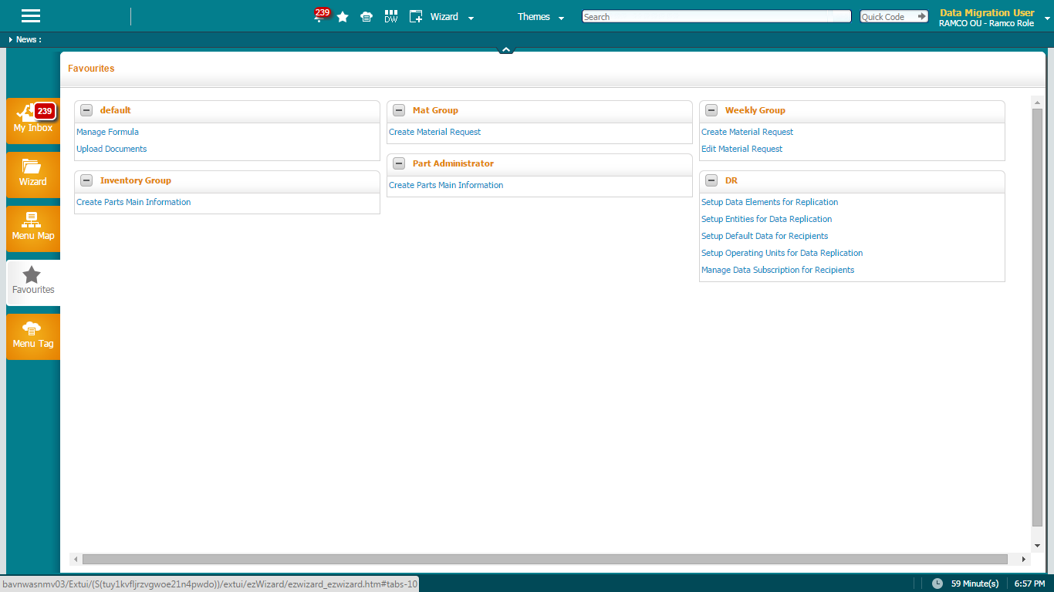
Chrysalis – User Defined Favourites
Launch Favourites
Favourites Group
Activities in the favourites group
Launch Favourites

Slide 57
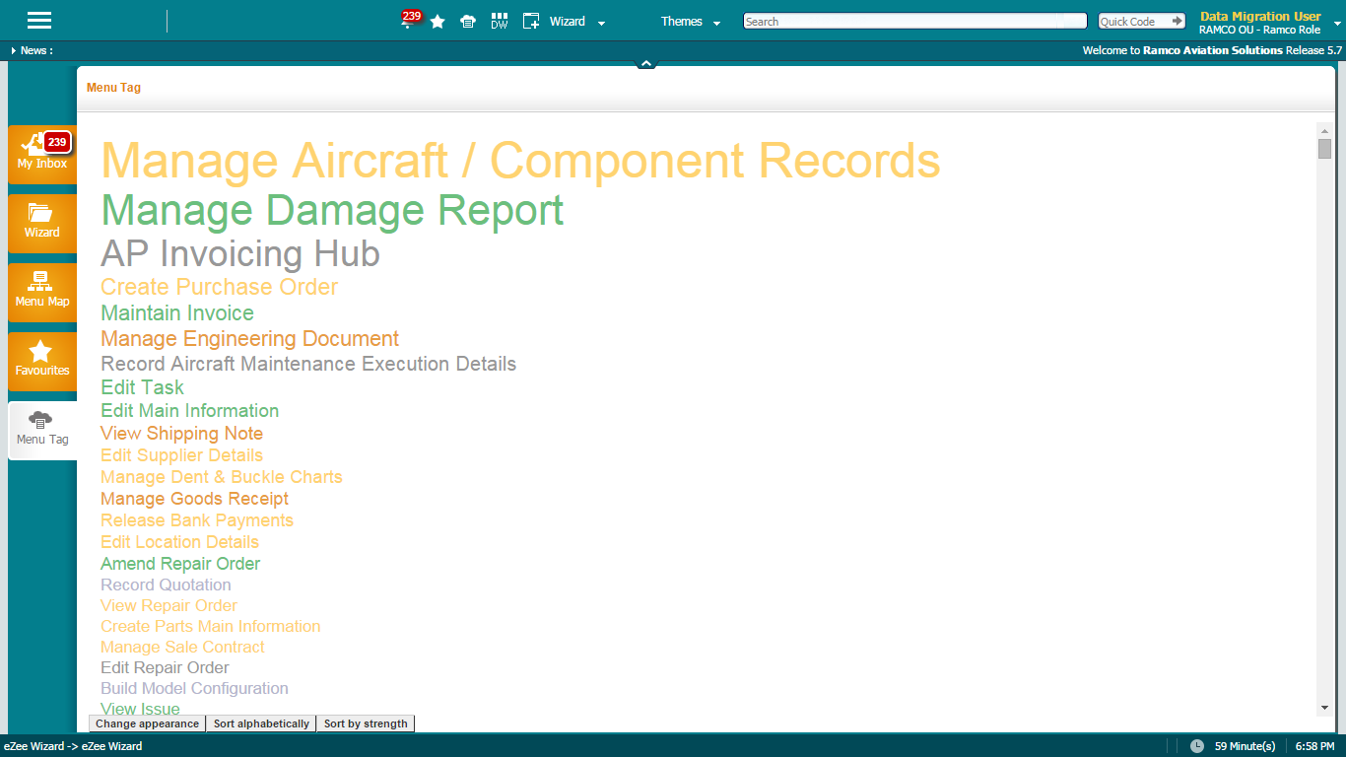
Chrysalis – Menu Tag
Launch Menu Tag
Frequently launched Activities
Launch Menu Tag
Sorting options
Displays activities in rows / Columns

Slide 58
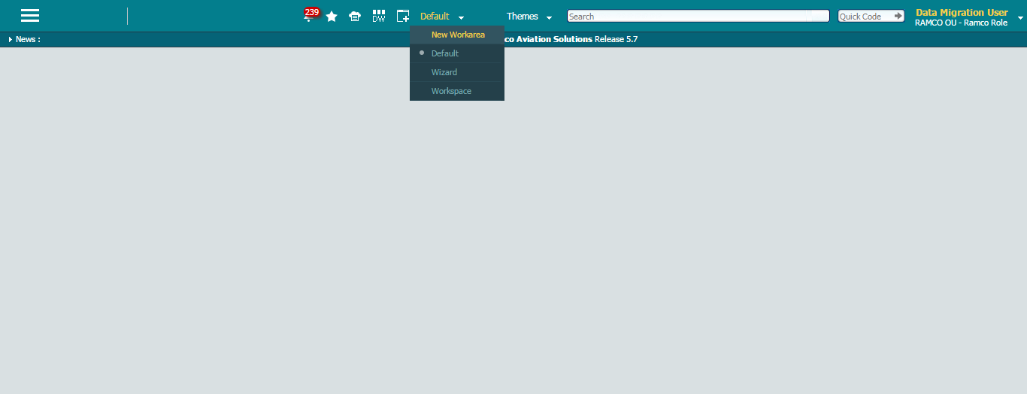
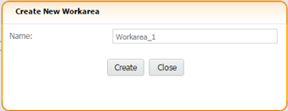
Chrysalis – Work Area
Click here to create a new Workarea
Create a new Workarea

Slide 59
Chrysalis – Work Area
Current Workarea
Click to toggle to workarea_1
Created Workareas

Slide 60
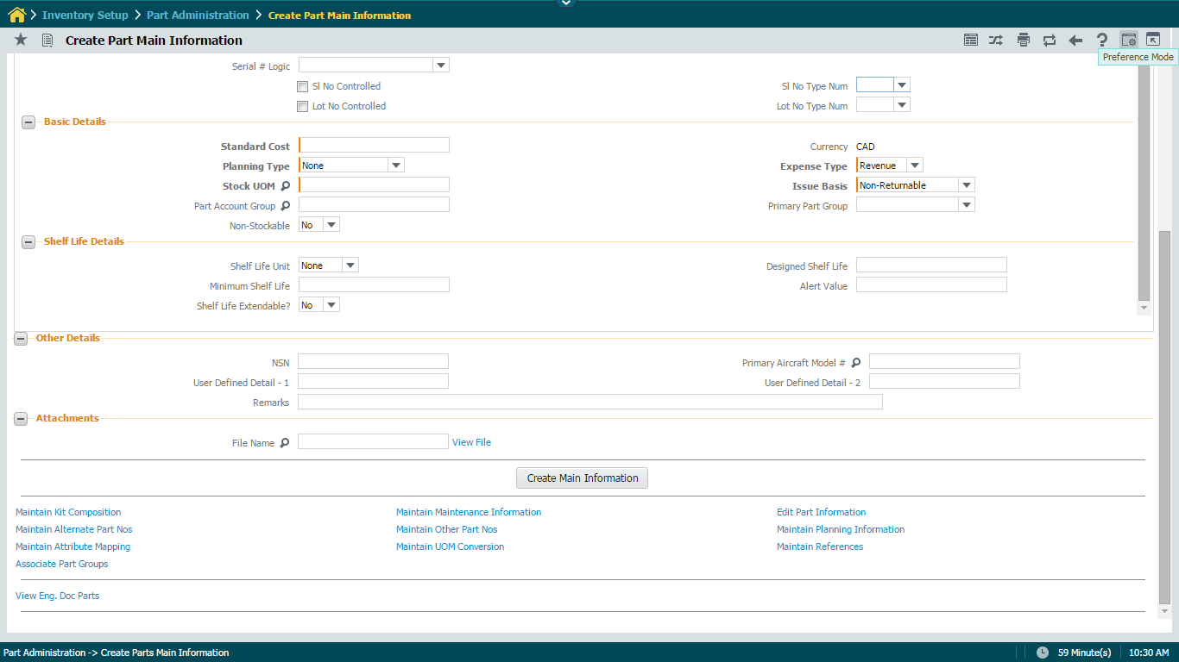
Chrysalis – Implementer Personalization
Click here to personalize.
Displays user / implementer personalization based on access rights.

Slide 61
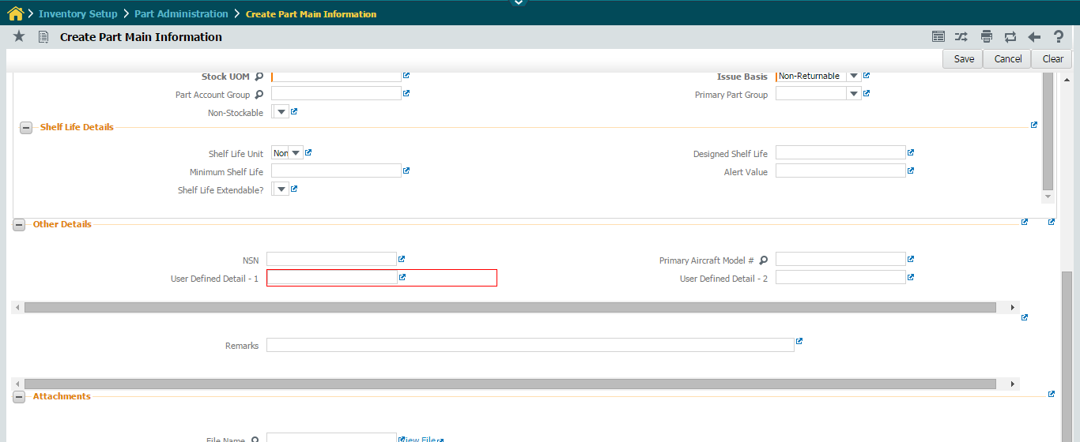
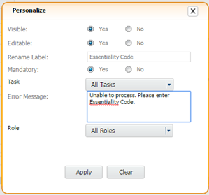
Chrysalis – Implementer Personalization
Click save to update
Show / hide control
Editable / display only control
Change control caption
Make a control mandatory
Select the Control to be personalized
Error message to be thrown if control is blank

Slide 62
Chrysalis – Implementer Personalization
Section Name modified
Control is made Display only
Control caption modified and made mandatory
User Defined Detail – 2 is hidden

Slide 63
Common Action Buttons – Change UI Preferences
Click here to
get options list
Click on Logout

Slide 64
Application Logout screen
Logout Page

Slide 65
Thank you
© Ramco Systems

