Slide 1
Common Conventions Ramco Aviation Solution – R5.7
Base Aviation Product Team
28-Apr-2014

Slide 2
Agenda
Accessing Ramco Aviation
Log-on
User Interface Organization
Navigation
Common Action Buttons
User Interface - Navigation
Screen Content
Messaging
Logout

Slide 3
Course Objective
At the end of the session, participants will be able to:
Perform common functions in the solution
Navigate within the solution
Be familiar with the conventions used in the solution
Perform data entry as well as retrieve existing data, in application pages

Slide 4
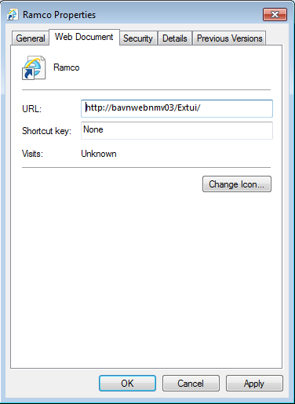
Accessing Ramco Aviation
Access the URL by:
Typing in IE’s Address control
Clicking on a shortcut for the URL on desktop
Clicking on a shortcut link in the “Favorites” list of IE
Ensure that the shortcuts have only the URL address
The htm page ref. needs to be removed if the “Add to Favorites”
option is used to create the link

Slide 5
Log-on
Supply log-on credentials
User ID
Password
User ID is locked if no. of unsuccessful attempts exceed set limit
Password expiry limit
User is warned on login, during the alert period set
Forgot Password link to reset the password
Additional Default log-on parameters for user
Default Role
Default Org. Unit/Location
Default Language

Slide 6
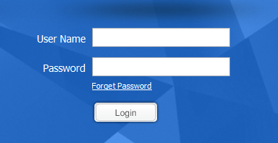
Common Actions: Forgot Password
Helps to Reset the password by answering the password reminder question

Slide 7
User Interface Organization
Business Process
Business Components
User Activities
User
Access Rights
User Activities
User Activities
User Interfaces

Slide 8
User Interface Organization (contd..)
Three primary windows
Login Page
Home Page
Main Page
Login Page

Slide 9
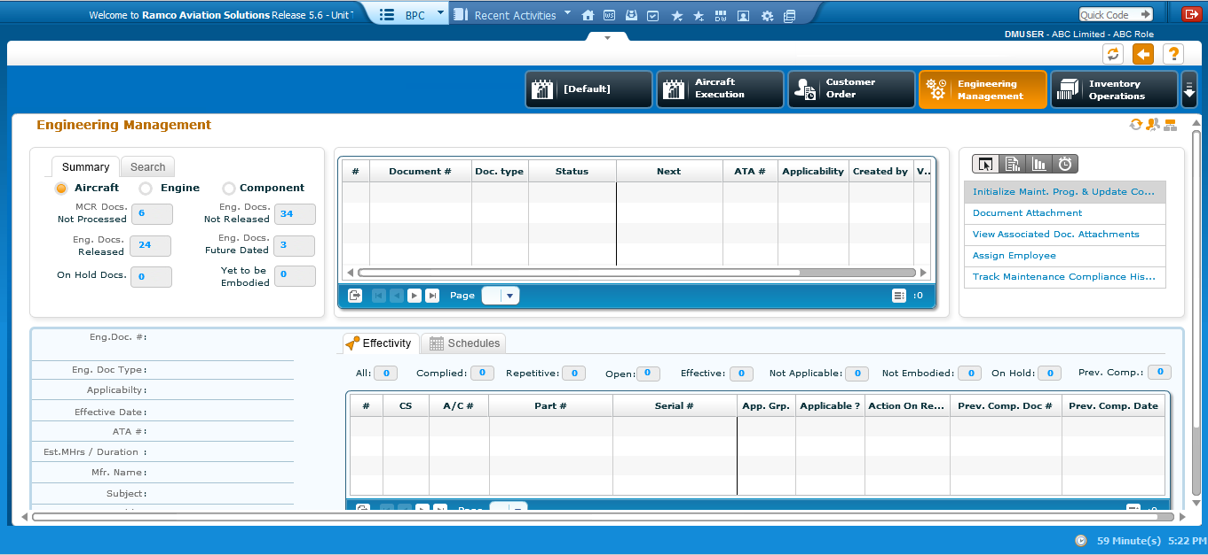
User Interface Organization (contd..)
Home Page
Workspace

Slide 10
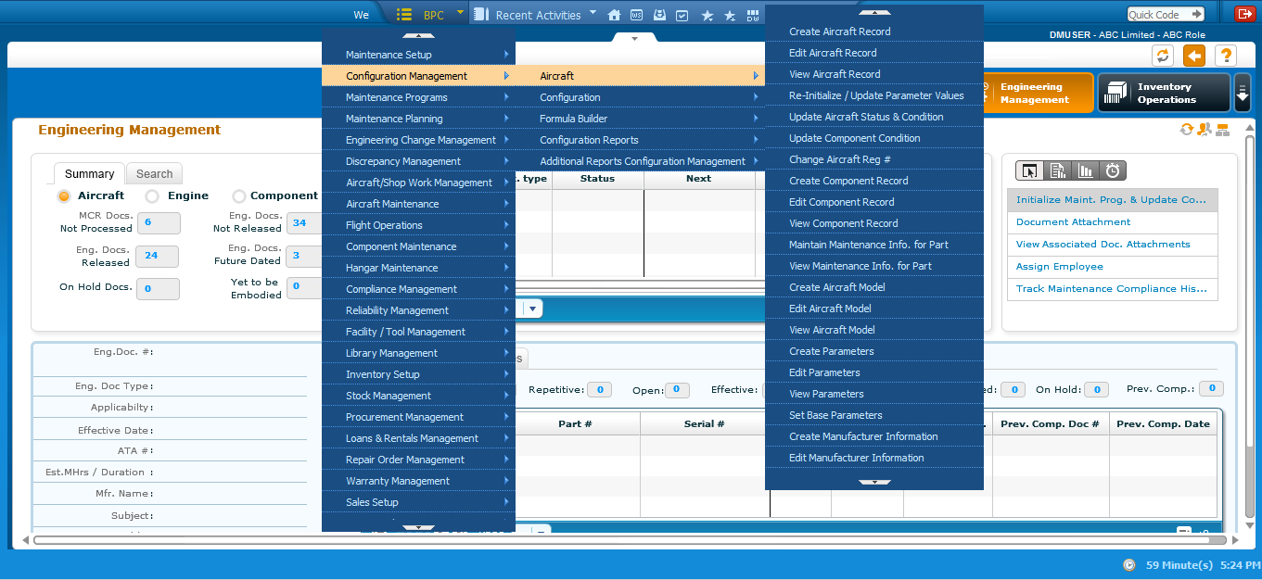
User Interface Organization (contd..)
Home Page
Lists the Business Processes
Only those processes which the user has access rights, will be listed
Favorites List
Frequently used activities
Launches the user interface (screen)
Business Component
Business Process Chain (BPC)
User Activity

Slide 11
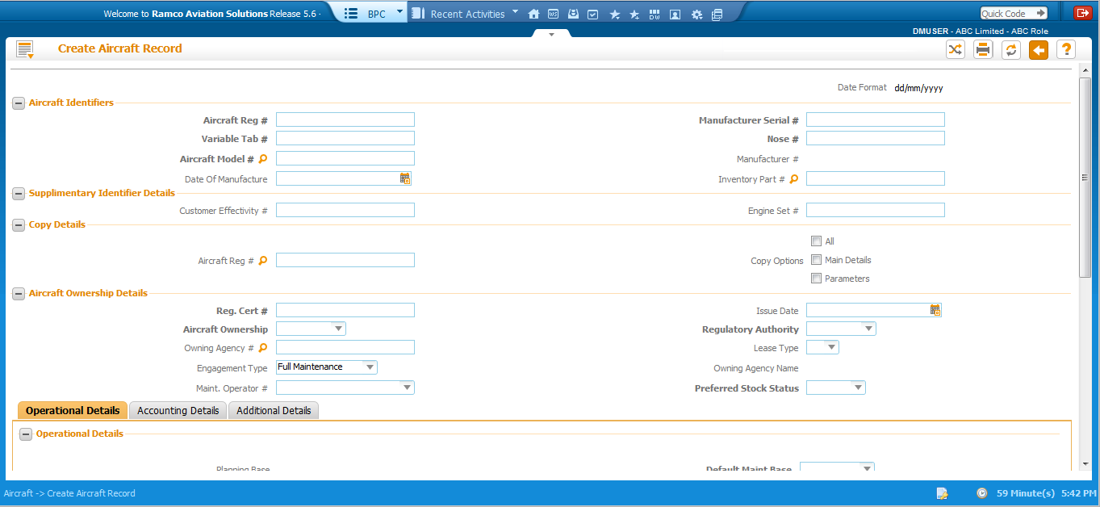
User Interface Organization (contd..)
Tool Bar
Common Action Buttons
Banner
a. Login User
b. Org. Unit
c. User Role

Slide 12
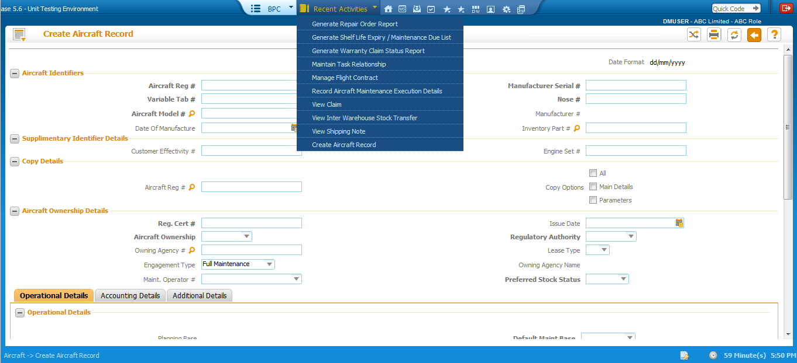
Navigation
System remembers recent activities till session logout

Slide 13
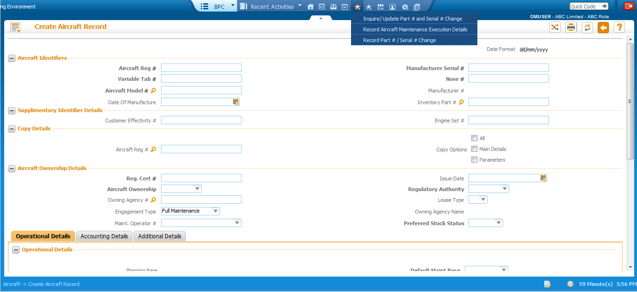
Navigation
User level favorites

Slide 14
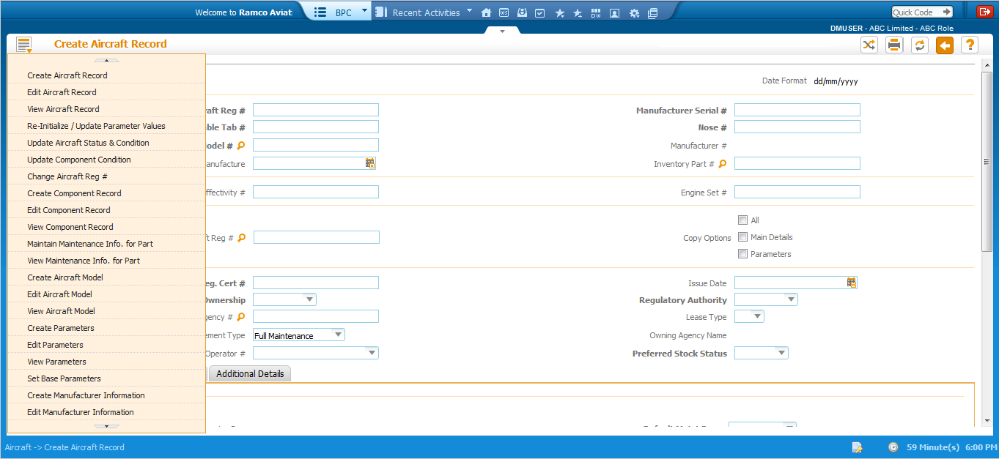
Navigation
Access menu available.
Menu for specific Business Process Chain (BPC)

Slide 15
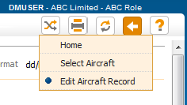
Navigation
Trail bar to display previous traversal

Slide 16
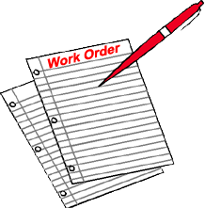
Common Action Buttons
Print Screen
Refresh Screen
Screen Level
Trial bar
Print screen
Refresh screen
Back
On-line Help
Trial bar
Back button to go back to previous screen
On-line Help

Slide 17
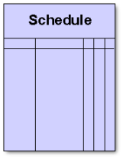
Common Action Buttons (contd..)
Go To Home Page
Show UI Page
Favorites
Launch DW
Settings
User Level
Go to Home page
Show workspace
Show UI Page
Set up Defaults
Favorites
Define Favorites
Launch DW
Change User Context
Settings
Launch New window
Show Workspace
Set up Defaults
Define Favorites
Change User Context
Launch New window
Session Level
Log-out

Slide 18
Common Action Buttons –Print Screen
Print Screen
Launches the Screen in a Printer friendly format

Slide 19
Common Action Buttons – Refresh Screen
Refresh
Brings the page back to the state in which it was first launched

Slide 20
Common Action Buttons – Go Back
Go Back
Closes the current screen and retrieves the previous screen

Slide 21
Common Action Buttons – Online Help
Online Help
Launches the “On-line” help for the page

Slide 22
Common Action Buttons – Quick Launch
Quick Launch facilitates launching of activities by providing short Id (integer)
Short ids for activities can be configured by generating an xml file ‘quick launch config.xml’
Xml file will reside in web server under /../iis/plf_data
Short ids should be integers
Short ids can be set at application level only

Slide 23
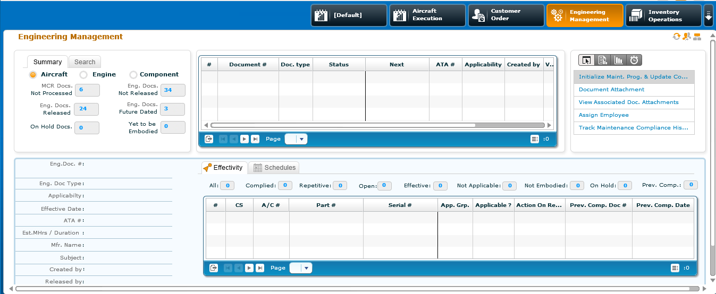
Common Action Buttons – Home

Slide 24
Common Action Buttons – Workspace

Slide 25
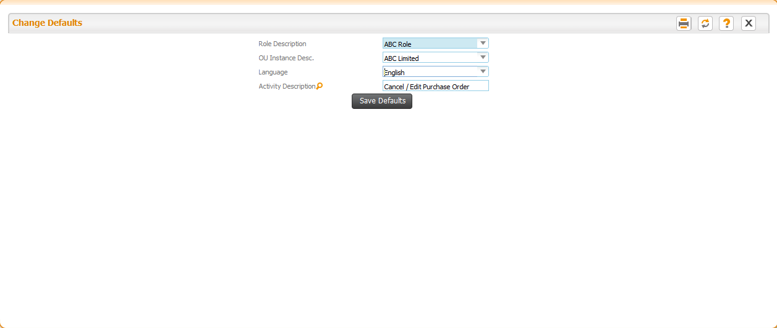
Common Action Buttons – Set up Defaults

Slide 26
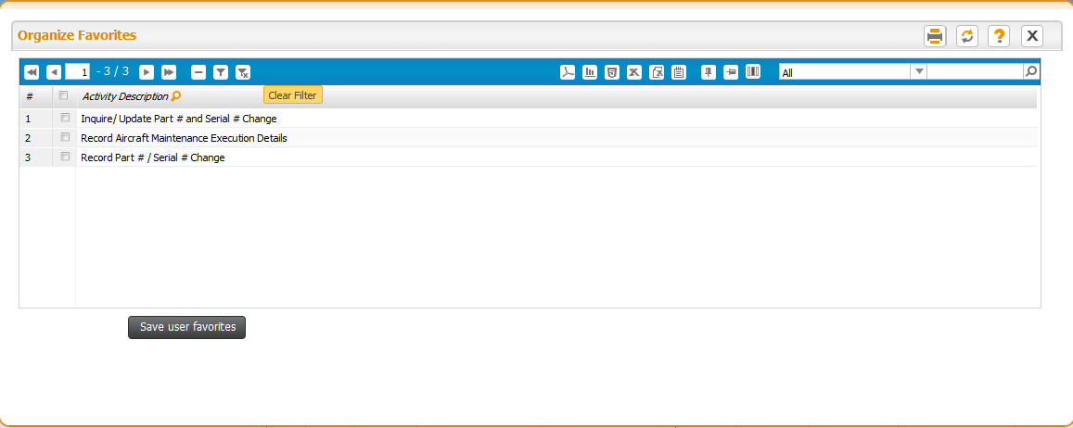
Common Action Buttons – Define Favorites

Slide 27
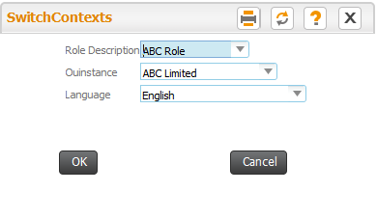
Common Action Buttons – Change User Context
Change context for the logged on user
Role
Org. Unit
Language

Slide 28
Common Action Buttons – Change User Context

Slide 29
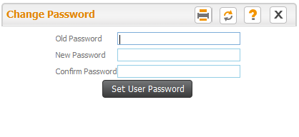
Common Action Buttons – Change Password

Slide 30
User Interface – Navigation
Pages can be invoked using:
Hyperlink of “User Activity” under the “Business Component”
Hyperlink of “User Activity” in the “Favorites” list of the “Home” page
Forward navigation across pages can be accomplished by:
Hyperlinks
Data-hyperlinks
“Help” icons

Slide 31
User Interface – Navigation (Contd.)
Hyperlink
Multiline Related
Will be positioned below a multiline
Would require one or more of the multiline rows to be selected
If linked page expects only one row to be selected and if multiple rows are selected in the multiline, then the last ordered record (among the selections made) will be considered.
Page Level
Ordered below the processing buttons
Exceptions in link positioning
“View File”

Slide 32
User Interface – Navigation (Contd.)
Data-hyperlinks
Used to
Navigate for viewing the details of any entity
“View” of master record for entities
“View” of main page for transactions
Navigate to detail page from an entry page

Slide 33
User Interface – Navigation (Contd.)
Help pages
Provided in controls where the system expects a valid pre-defined data-item to be entered.
Help icon invokes a page where all the pre-defined records are available for selection.
Press “OK” button (or) double click the record to close the help page and retrieve the selected record(s) back to the control

Slide 34
User Interface – Navigation (Contd.)
Backward traversals
Accomplished by:
Closing the page using the “Close” common action button
Clicking on the User Interface name in trail bar
Invoking “OK” button in a “help” page

Slide 35
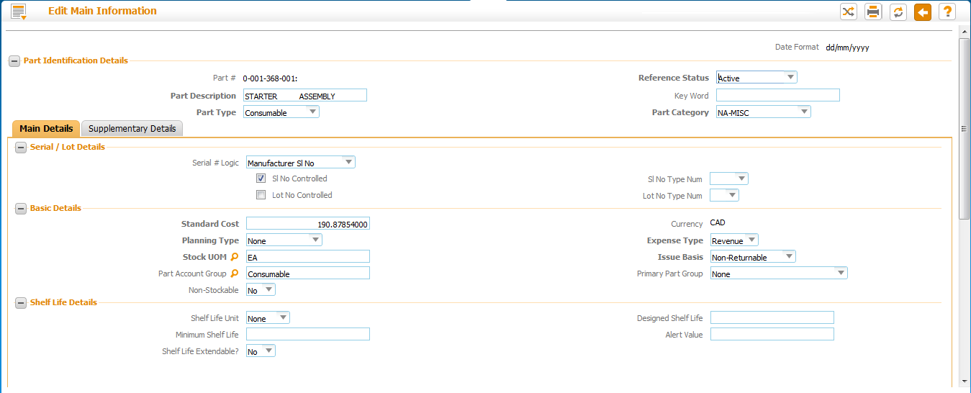
Page Content
Page Title
Display Control
Labels
Cluster Heading/Captions
Mandatory Control, Text
Check box
Drop down, Mandatory
Editable numeric control
Help Enabled Control
Editable Control
Processing/Action Button
Section Collapse Option

Slide 36
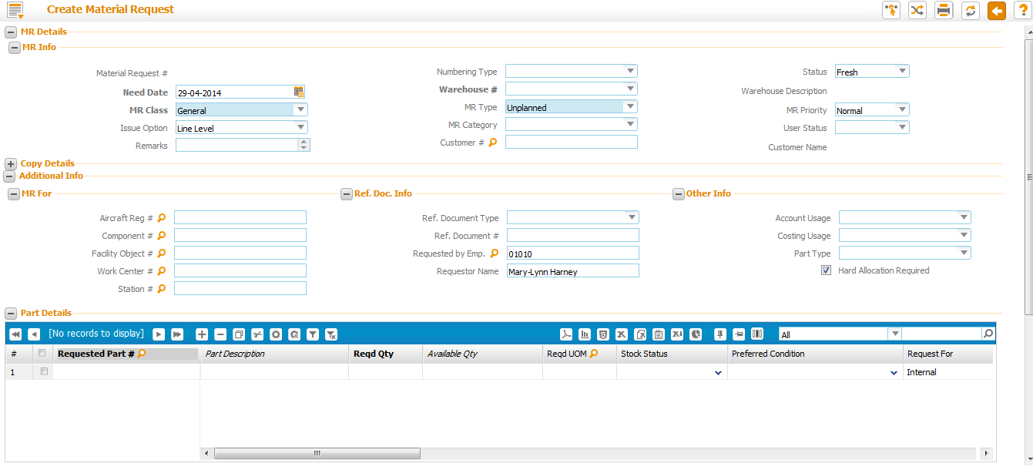
Page Content
Date & Time Icon
Option to default column values
Option to rename or delete columns (User level)
Multiline (Grid)
Option to filter data from multiline

Slide 37
Page Content (Contd.)
Text Area
Use “Tab” to move to the next editable control in the same line / next line
Mandatory fields
Will be displayed with label in Bold font
Conditionally Mandatory fields
Will be displayed as non-mandatory
Hot key ‘Alt + F’ will execute ‘Search’ function in all search pages
Controls that are enabled for multiple search criteria are labeled with *

Slide 38
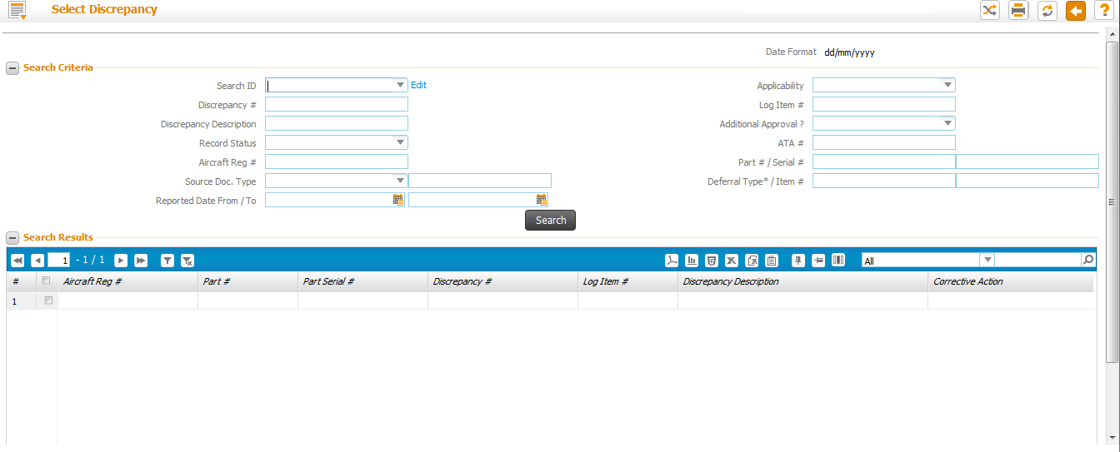
Page Content – Multiple Search Criteria
* Used to indicate multiple values can be entered for search purposes

Slide 39
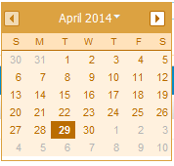
Page Content (Contd.)
Date & Time Controls - Pop up
Invoke the Icon next to the control or
Press F2 when cursor is in editable controls
Dropdown helps in moving across years
Previous & Next icons help in moving across months

Slide 40
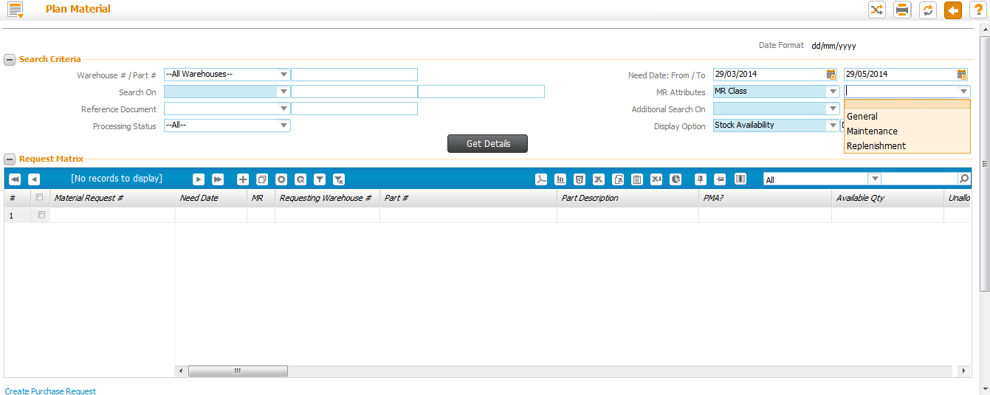
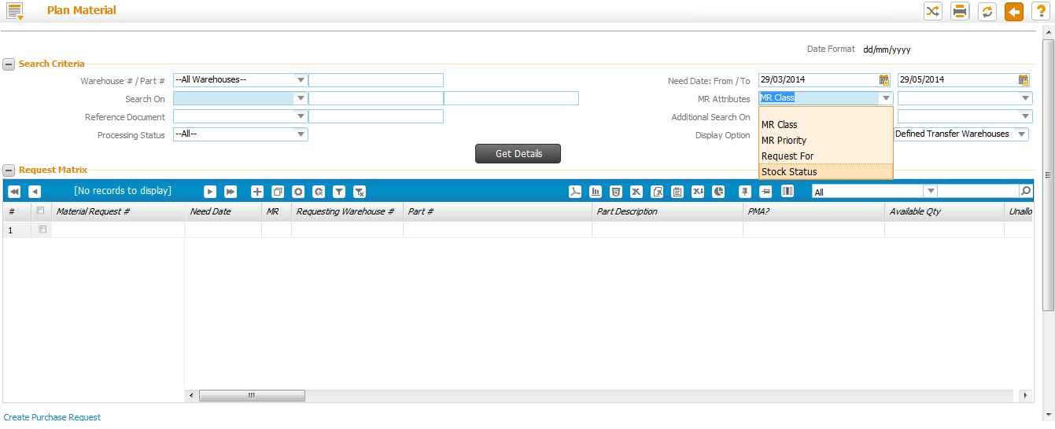
Page Content – State Processing
Controls that drive behavior or data in another dependent control are identified with grey color background
Controls that drive behavior or data in another dependent control are identified with blue color background

Slide 41
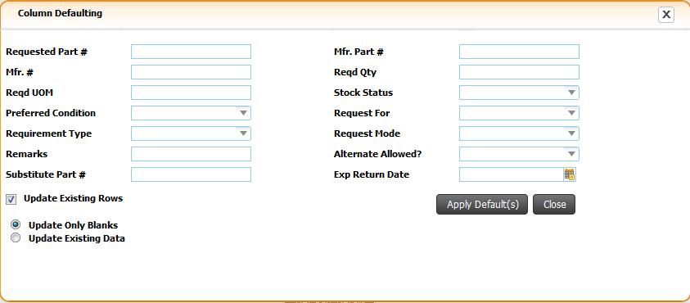
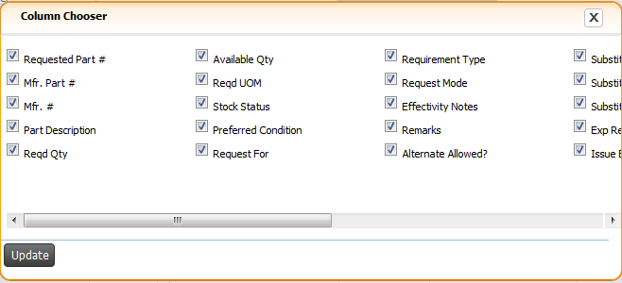
Page Content – Working with Grid
Show Html
Remove Personalize
Show Report
Save Personalize
Export to CSV
Filter column: Option to delete or rename column
Show PDF
Export to Excel
Show Chart
First Record
Import Data
Vertical Scroll- Previous Set
Export to Text
Select column to search
Direct Access to Row
Row count display
Vertical scroll – Next set of row
Last row
Add new row
Remove selected row
Copy Append
Cut and paste
Default Columns
Clear Defaults
Filter Data
Clear Filters
Enter search values
Column Sort is enabled
Locking of specific column
Horizontal Scroll

Slide 42
Page Content – Working with Grid
Click on the # to view the multiline record in a form.

Slide 43
Page Content – Working with Grid
Multiple Short Keys are enabled in Grid
Image | Short Key | Functionality
 | Shift + Insert | Insert new row in grid
 | Shift + Delete | Delete selected row in grid
 | Ctrl + Y / F7 | Copy and Insert selected row(s) in to the grid
 | Ctrl + X / F8 | Cut and Insert selected row(s) in to the grid
 | Pageup | Move to previous row set
 | Pagedown | Move to next row set
 | End | Move to last row set
 | Home | Move to first row set
 | Shift + p | Show PDF
 | Shift + r | Show report
 | Shift + h | Show HTML
 | Shift + e | Export to excel
 | Shift + v | Export to csv
 | Shift + t | Export to text
 | Shift + I | Import Data
 | Shift + c | Show chart
 | Shift + s | Save personalize
 | Shift + d | Remove personalize

Slide 44
Page Content: Working with Tab Controls
Press Tab heading to navigate across tabs
Active Tab
Inactive Tab

Slide 45
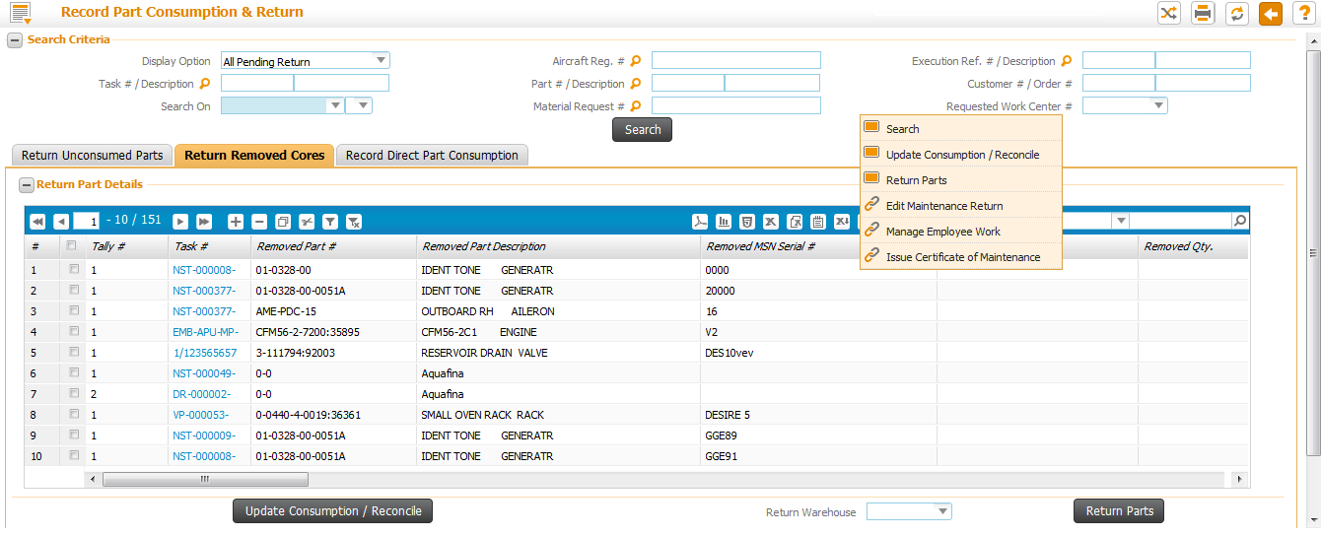
Page Content– Quick Access
Easy access of buttons and links on Right Click of Mouse

Slide 46
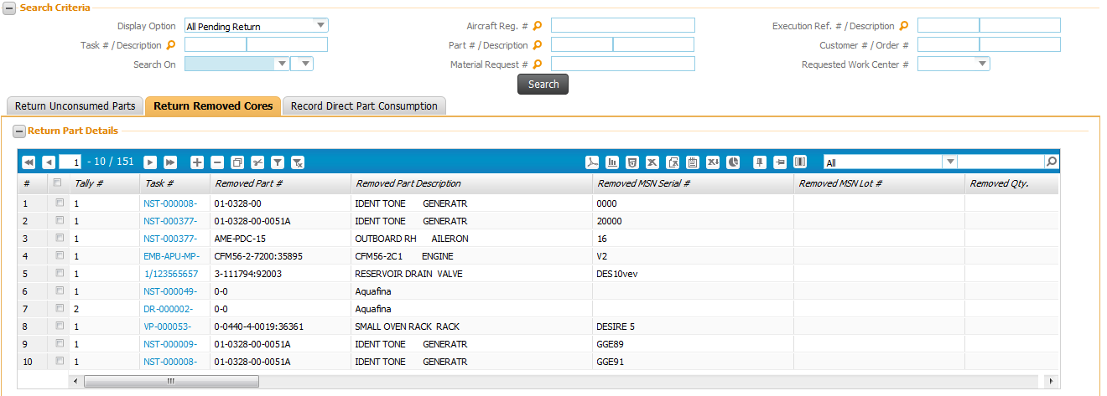
Page Content – Collapse & Expand Sections
Invoke expand icon to Collapse the section
Invoke collapse icon to Collapse the section

Slide 47
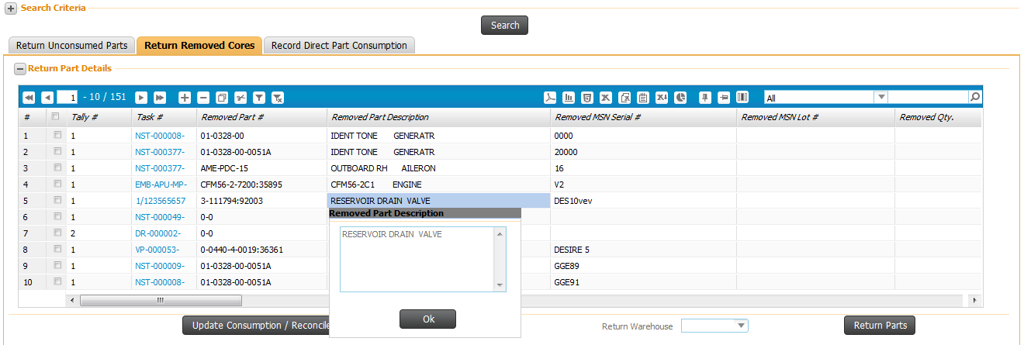
Control Content
Function key ‘F2’ on any edit control will launch the content in a pop-up window for easy readability

Slide 48
Multiline Content in Tool tip
Content of a cell in a multiline can be viewed over tool tip just by moving cursor on the cell

Slide 49
Messaging
Application Messages
Displayed when any processing action initiated
Errors
Informational messages
System Messages
Incorrect Date/Time formats
Displayed when tabbing out of the date/time control
“Page not saved” warning messages
Displayed while executing a backward traversal

Slide 50
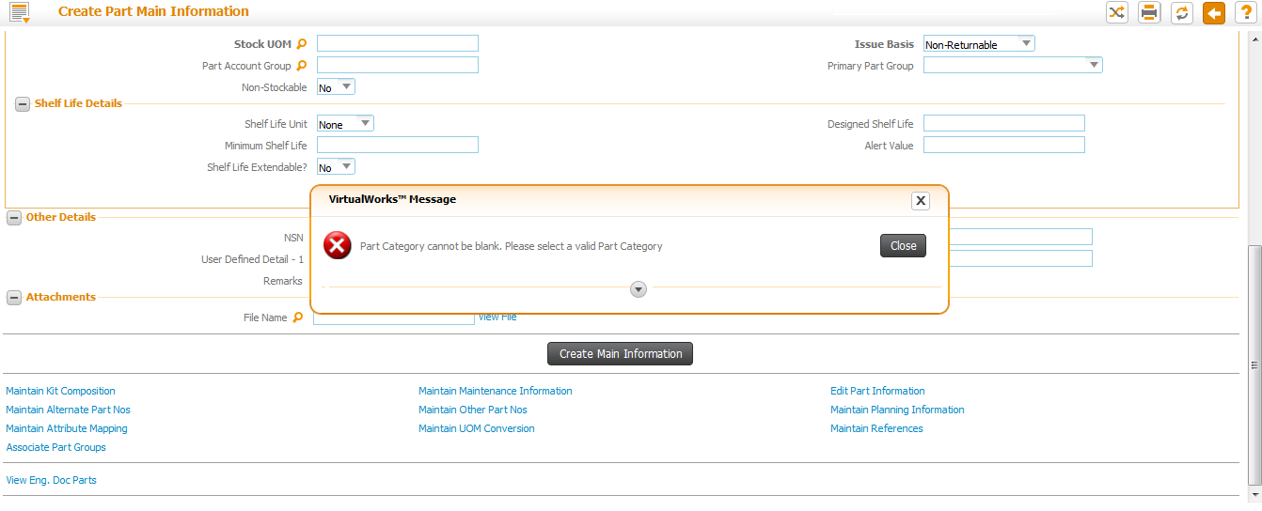
Messaging (Contd.)
Application Message
Error Messages always displayed in Pop-up window

Slide 51
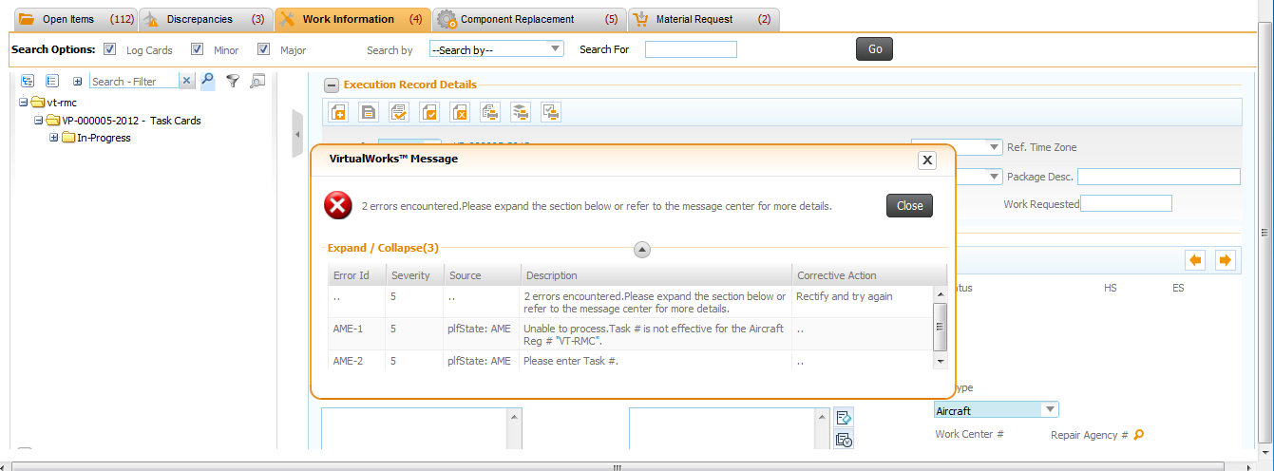
Messaging (Contd.)
In Aircraft Maint. Exec. Business components multiple messages can be seen at a time using this expand icon. Error message information will also be available in the Message Center available at the screen bottom

Slide 52
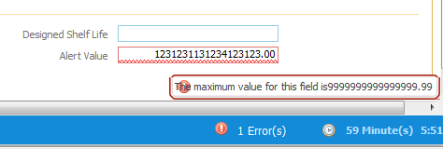
Messaging (Contd.)
System Message

Slide 53
Messaging (Contd.)
System Messages..contd.
Session time out expiry
The remaining time is always displayed on the screen.
When the expiry time is nearing, system will start flashing the same.
Countdown starts from the last request by the user to web server
Page launch, Processing actions
Does not recognize data entry actions
Auto log-off if no action is performed

Slide 54
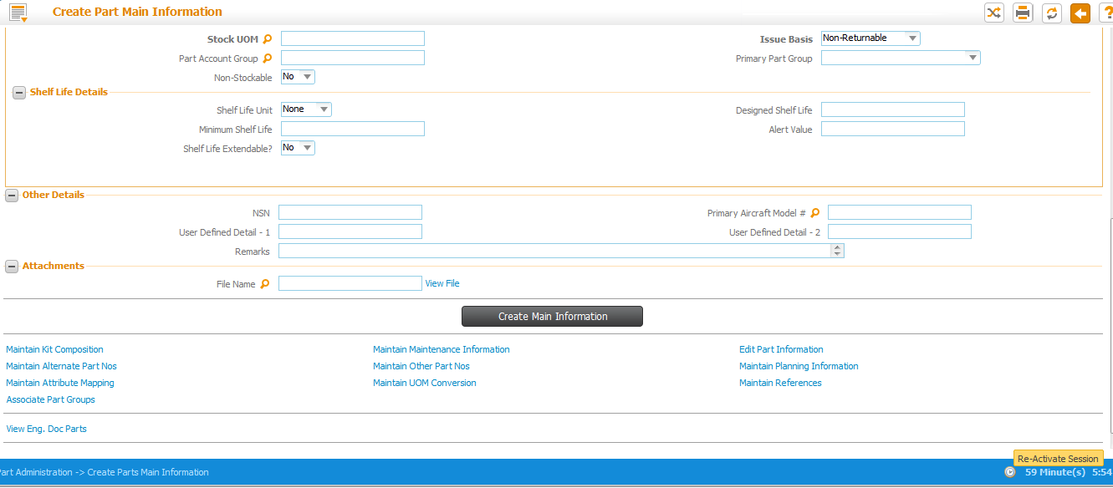
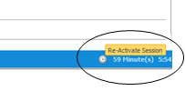
Messaging (Contd.)
Session Expiry Time

Slide 55
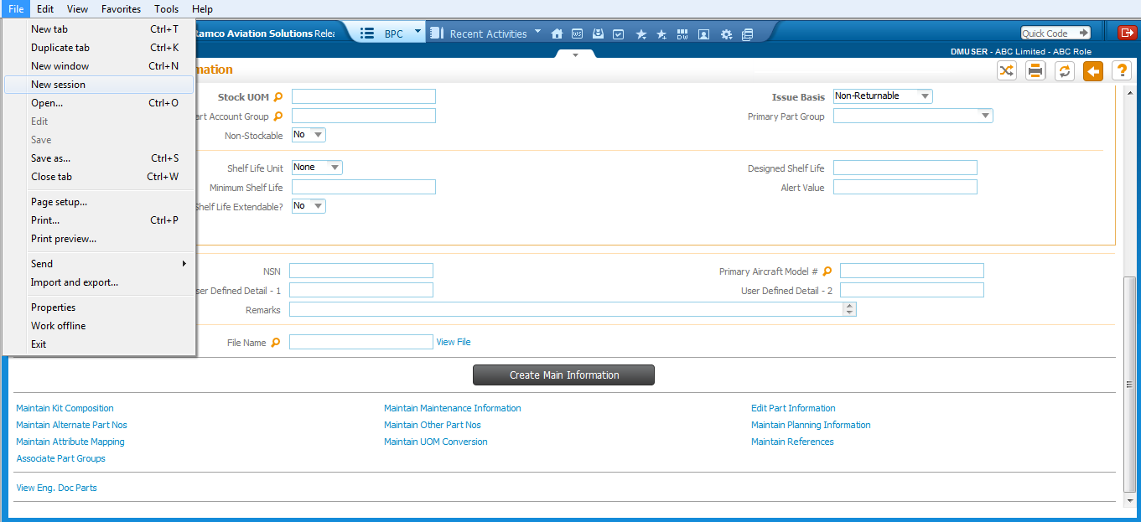
Multiple IE Windows
Launching of multiple windows enabled by opening a new session in IE

Slide 56
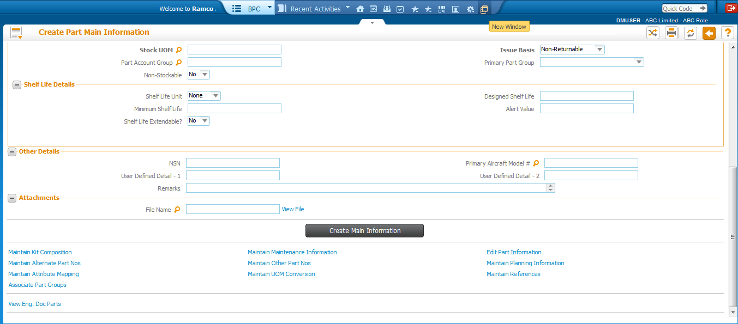
Multiple IE Windows – Cont..
Click on New window icon to launch new application session in different window.

Slide 57
Application Logout screen
Logout Page

Slide 58
Thank you
© Ramco Systems

