Slide 1
USER CENTERED DESIGN
My Warehouse
UCD
1.1
31/03/2015

Slide 2
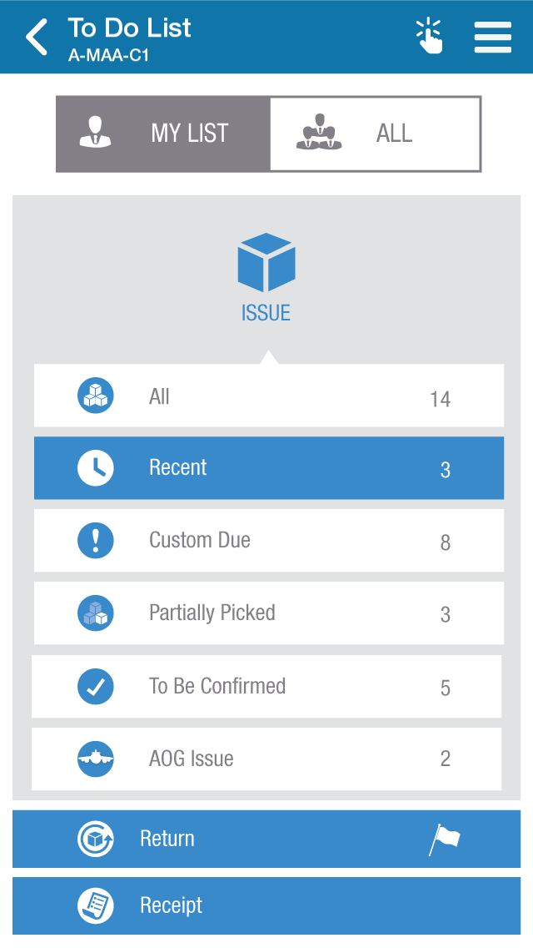
Landing Page
Header Panel
Height : 88px
Color : #0076a9
Icon size
44*44px
Height: 90px
BG : 817d84
Icon size
70*70px
610*725px
BG : e0e0e0
546*75PX
Colour: 3889c9
Icon size
44*44px

Slide 3
Thank you

