Slide 2
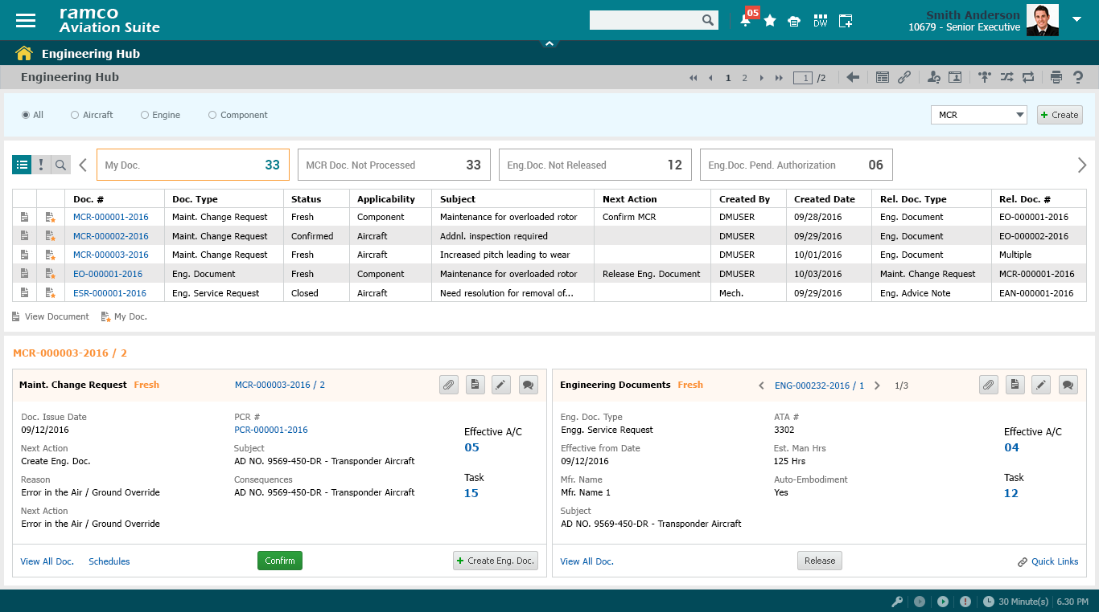
Engineering Hub - MCR

Slide 3
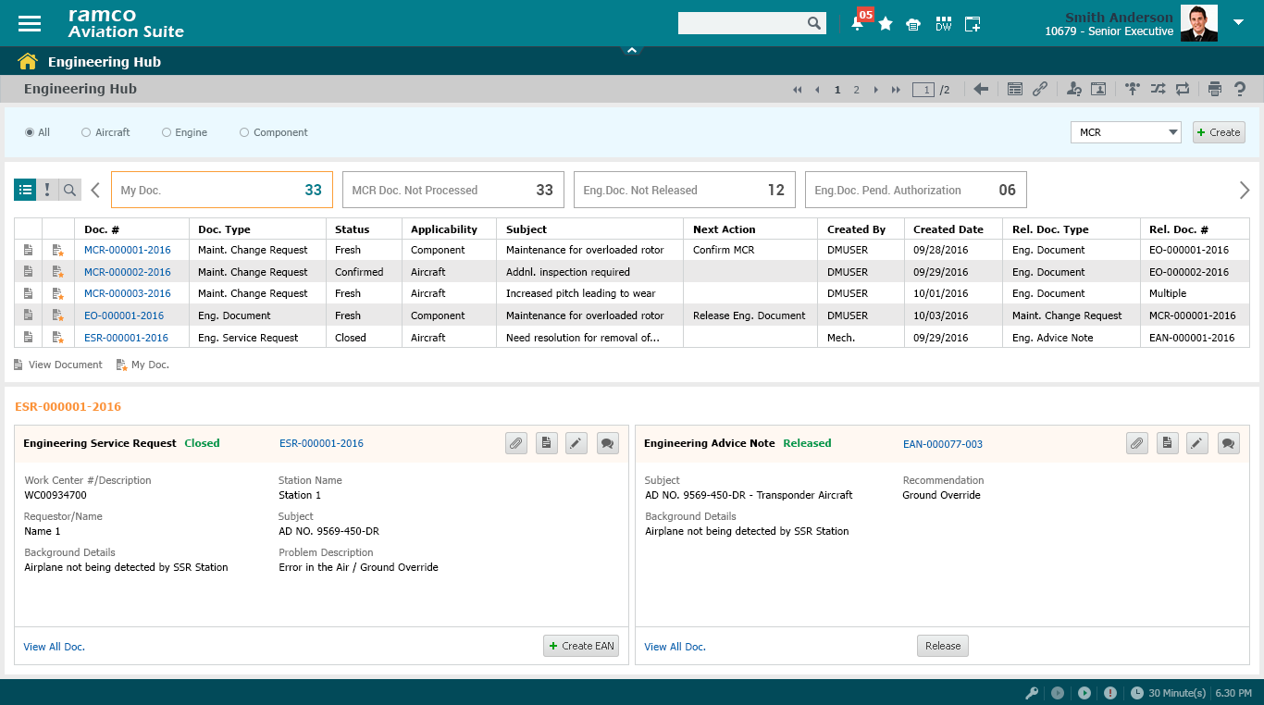
Engineering Hub - ESR

Slide 4
Engineering Hub - Exception

Slide 5
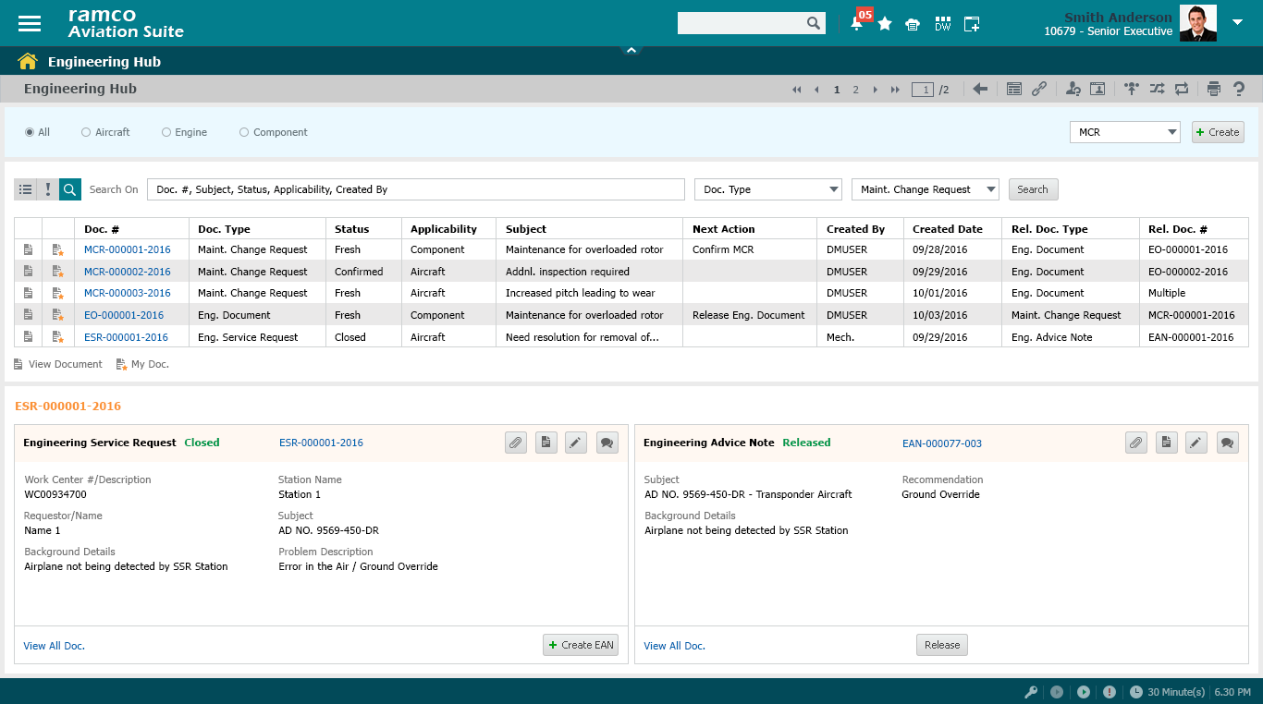
Engineering Hub – Search On

